Slide 1




6
Our school
LESSON 2 PERIOD 3

Slide 2
Contents
Warm-up and new words
Activity 1
01
02
Activity 2
Activity 3
03
04
Sing a song and learn new words.
Look, listen and repeat.
Listen, point and say.
Let’s talk.
Fun corner
05
Game

Slide 3
Warm-up

Slide 4

Let’s sing.

Slide 5
New words

Slide 6

computer room

Slide 7
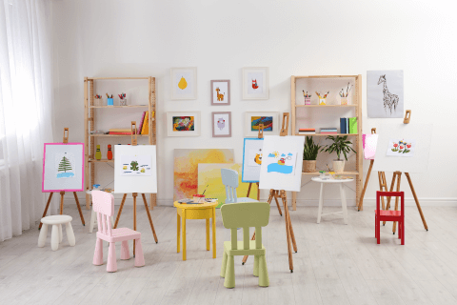
art room

Slide 8
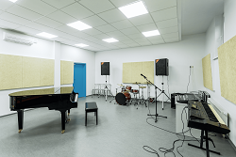
music room

Slide 9

gym

Slide 10
Look and guess.

Slide 11
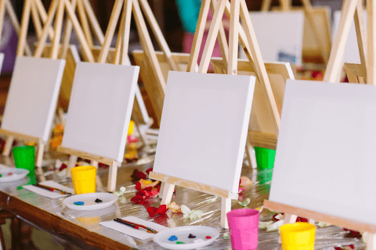
1
2
3
4
5
6
7
8
9
art room
Notes:
Click a numbered square to make the square disappear.
Click the image to reveal it. All the squares will disappear.

Slide 12
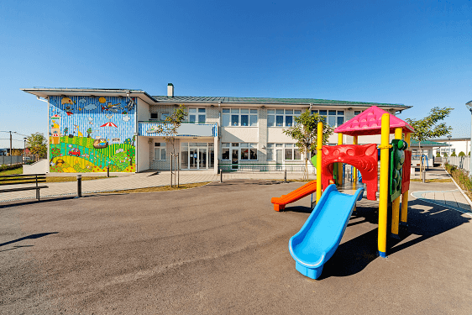
1
2
3
4
5
6
7
8
9
playground
Notes:
Click on a numbered square to make the square disappear.
Click on the image to reveal it. All the squares will disappear.

Slide 13

1
2
3
4
5
6
7
8
9
music room
Notes:
Click on a numbered square to make the square disappear.
Click on the image to reveal it. All the squares will disappear.

Slide 14

1
2
3
4
5
6
7
computer room
8
9
Notes:
Click on a numbered square to make the square disappear.
Click on the image to reveal it. All the squares will disappear.

Slide 15

1
2
3
4
5
6
7
8
9
library
Notes:
Click on a numbered square to make the square disappear.
Click on the image to reveal it. All the squares will disappear.

Slide 16
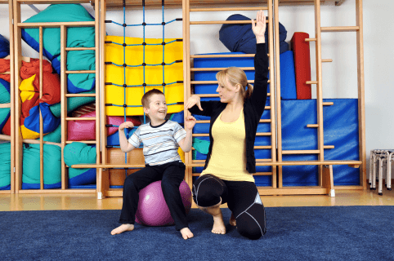
1
2
3
4
5
6
7
8
9
gym
Notes:
Click on a numbered square to make the square disappear.
Click on the image to reveal it. All the squares will disappear.

Slide 17
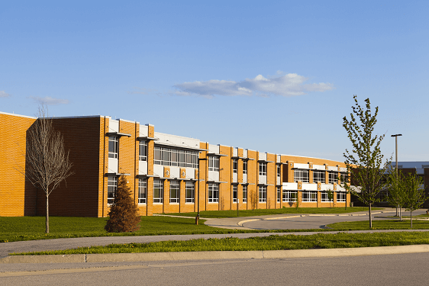
1
2
3
4
5
6
7
8
9
school
Notes:
Click on a numbered square to make the square disappear.
Click on the image to reveal it. All the squares will disappear.

Slide 18

Look, listen and repeat.

Slide 19
Look and answer the questions.
Where are they?
What are they doing?
Who are they?

Slide 20
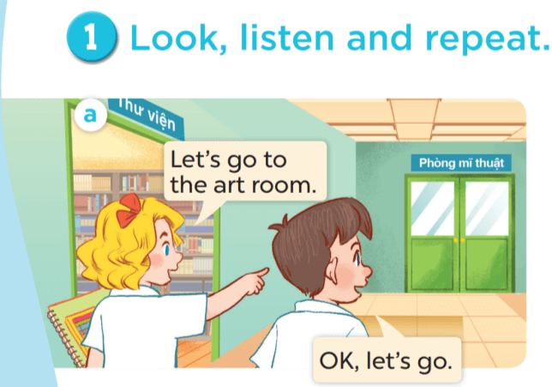

Slide 22
Work in pairs. Practise.
Listen and repeat.

Slide 23

Listen, point and say.

Slide 24
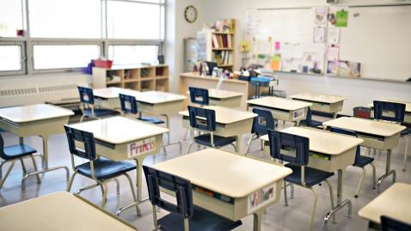


Let’s go to our classroom.
Ok, let’s go.

Slide 25
Let’s go to the library.
Ok, let’s go.

Slide 26
Let’s go to school.
Ok, let’s go.

Slide 27
Let’s go to the playground.
Ok, let’s go.

Slide 28
Work in pairs. Practise.

Slide 29

Let’s talk.

Slide 31

Fun corner

Slide 32



Game time
1
2
3
4
5
6
7
8
Notes:
Divide the class into 2 teams.
The teams take turns to choose a lucky number, say the word and make a sentence with that word, using the sentence model.
Give points to the teams.

Slide 33

Let’s …………………
Ok, let’s go.

Slide 34

Let’s …………………
Ok, let’s go.

Slide 35

Let’s …………………
Ok, let’s go.

Slide 36

Let’s …………………
Ok, let’s go.

Slide 37


Let’s …………………
Ok, let’s go.

Slide 38
Let’s …………………
Ok, let’s go.

Slide 39
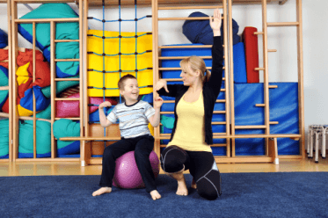

Let’s …………………
Ok, let’s go.

Slide 40


Let’s …………………
Ok, let’s go.

