Slide 1




6
Our school
LESSON 1 - PERIOD 2

Slide 2
Contents
Warm-up and review
Activity 4
01
02
Activity 5
Activity 6
03
04
Listen and tick
Look, complete and read
Let’s sing
Fun corner
05
Game

Slide 3
Hello, boys and girls. Welcome to our lesson today.

Slide 4

WARM-UP and REVIEW

Slide 5
Warm-up

Slide 6
Is this our…….?
1
2
3
Notes:
Divide the class into 3 teams.
Each team has 1 sticky ball.
Play the music. Pupils in each team take turns to pass the ball. After the music ends, 3 pupils who have the ball stand up and say the words school, classroom, library, playground,
then make sentences using the sentence model.

Slide 7

LISTEN AND TICK.

Slide 8


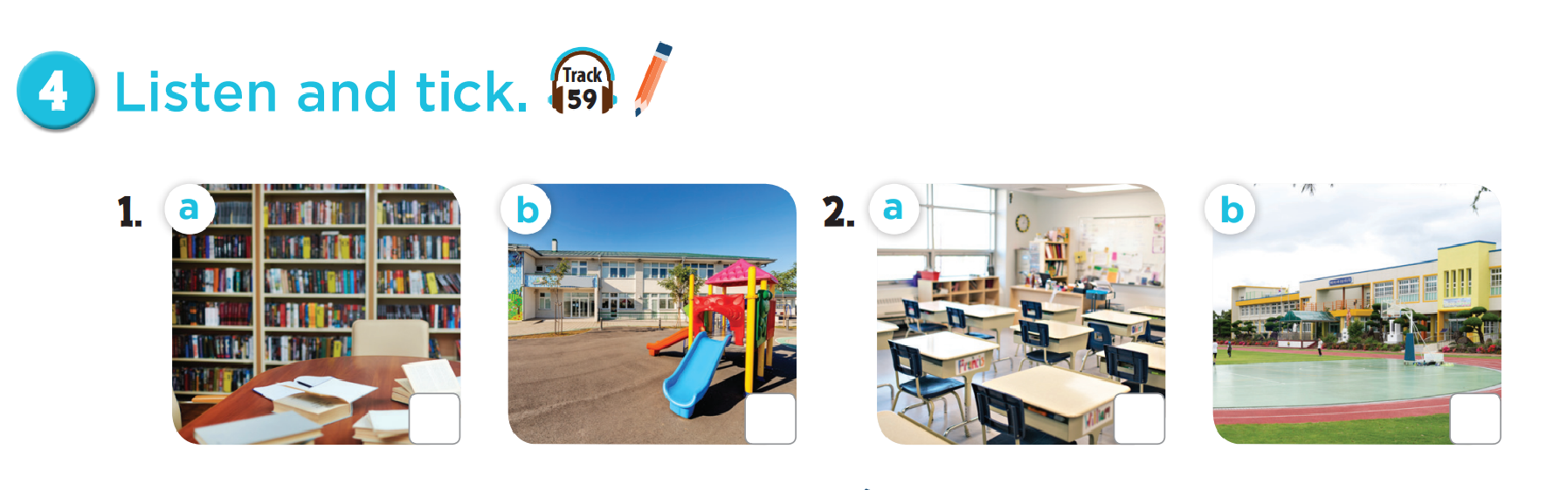

Slide 9

LOOK, COMPLETE
AND READ.

Slide 10
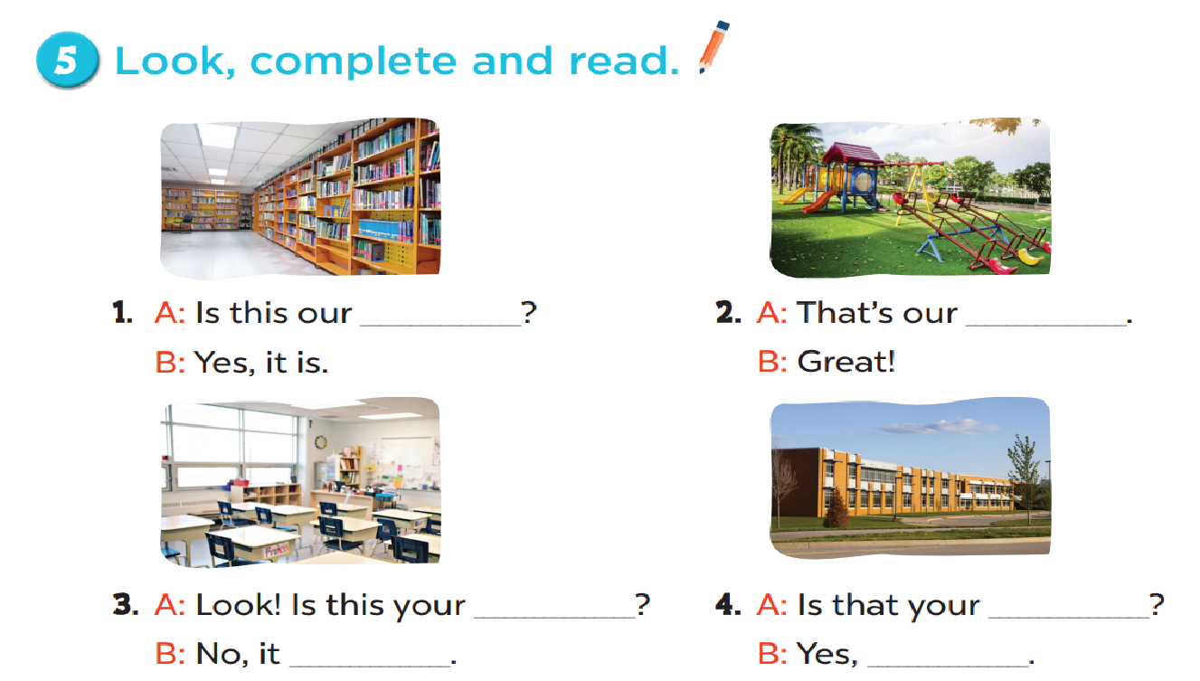
library
playground
classroom
school
isn’t
it isn’t

Slide 11

LET’S SING.

Slide 12
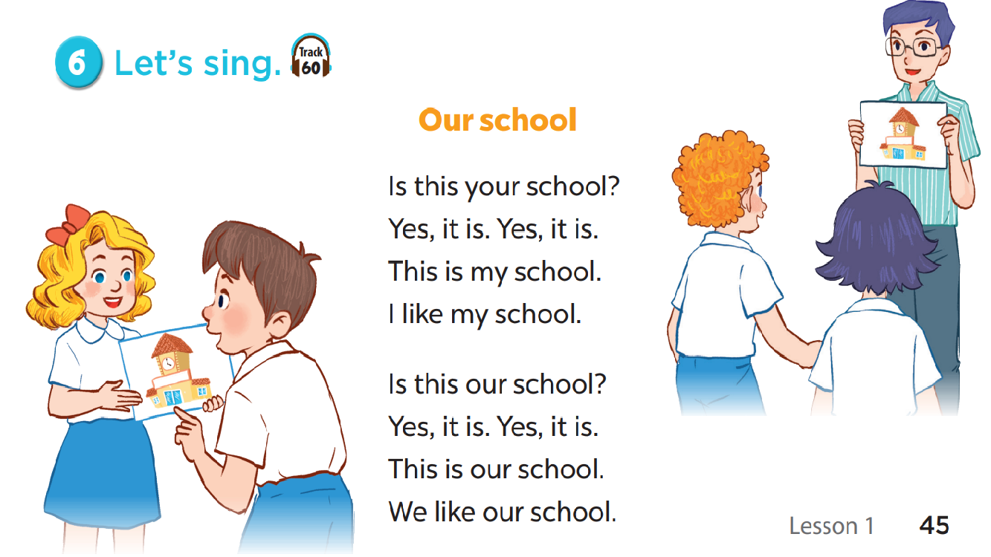

Slide 13

FUN CORNER

Slide 14







5
10
15
20
15
25
10
🡪

Slide 15

Read and choose.
………… this your classroom?
Is
Is
Are

Slide 16

Read and choose.
That is our…………………………
playground
playground
classroom

Slide 17

Read and choose.
Is ……….your classroom?
they
that
that

Slide 18

Read and choose.
Is that your library?
Yes, it isn’t.
Yes, it is.

Slide 19

Read and choose.
Is that ………….school?
look
your
your

Slide 20

Read and choose.
Is this our playground?
No, it isn’t.
No, it is.

Slide 21
Read and choose.
Is that your……………..?
library
school
school

