Slide 1




6
Our school
LESSON 1 PERIOD 1

Slide 2
Contents
Warm-up and new words
Activity 1
01
02
Activity 2
Activity 3
03
04
Sing a song and learn new words.
Look, listen and repeat.
Listen, point and say.
Let’s talk.
Fun corner
05
Game

Slide 3
Warm-up

Slide 4

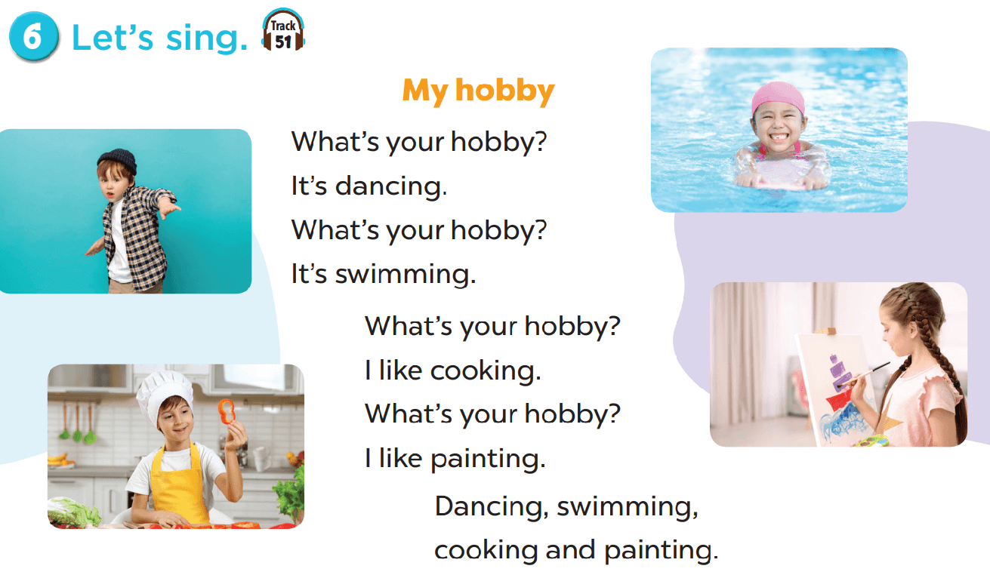
Let’s sing.

Slide 5
New words

Slide 6
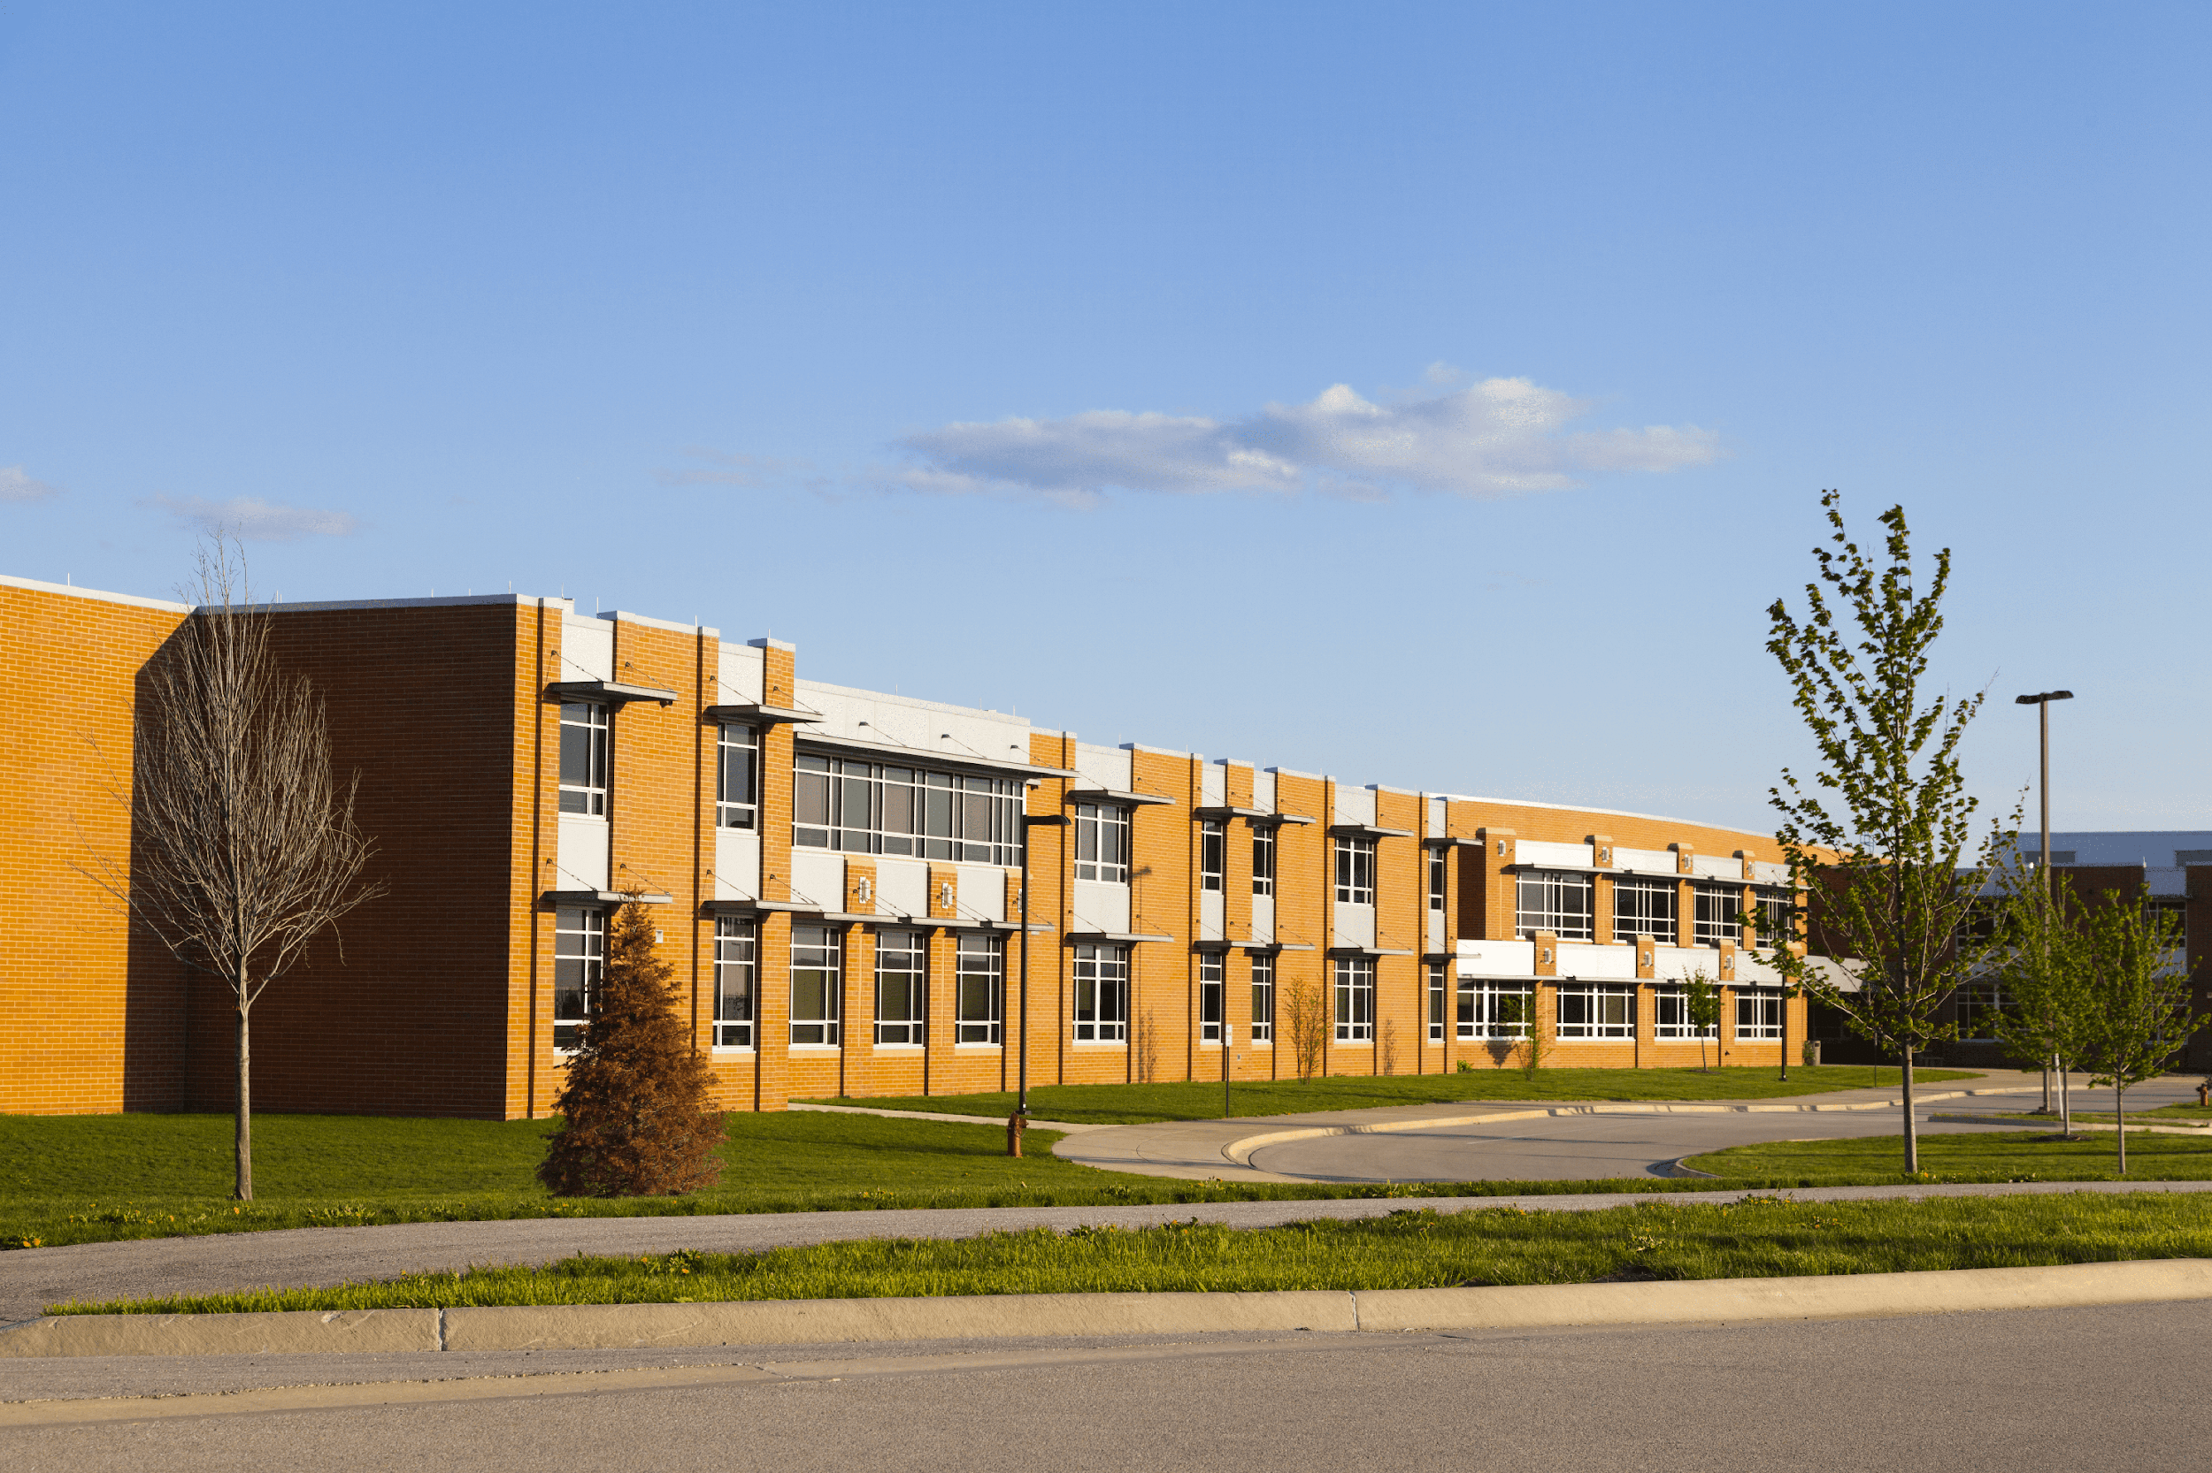
school

Slide 7
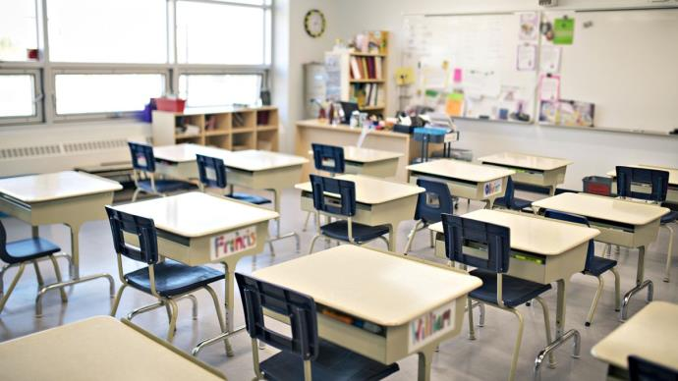
classroom

Slide 8
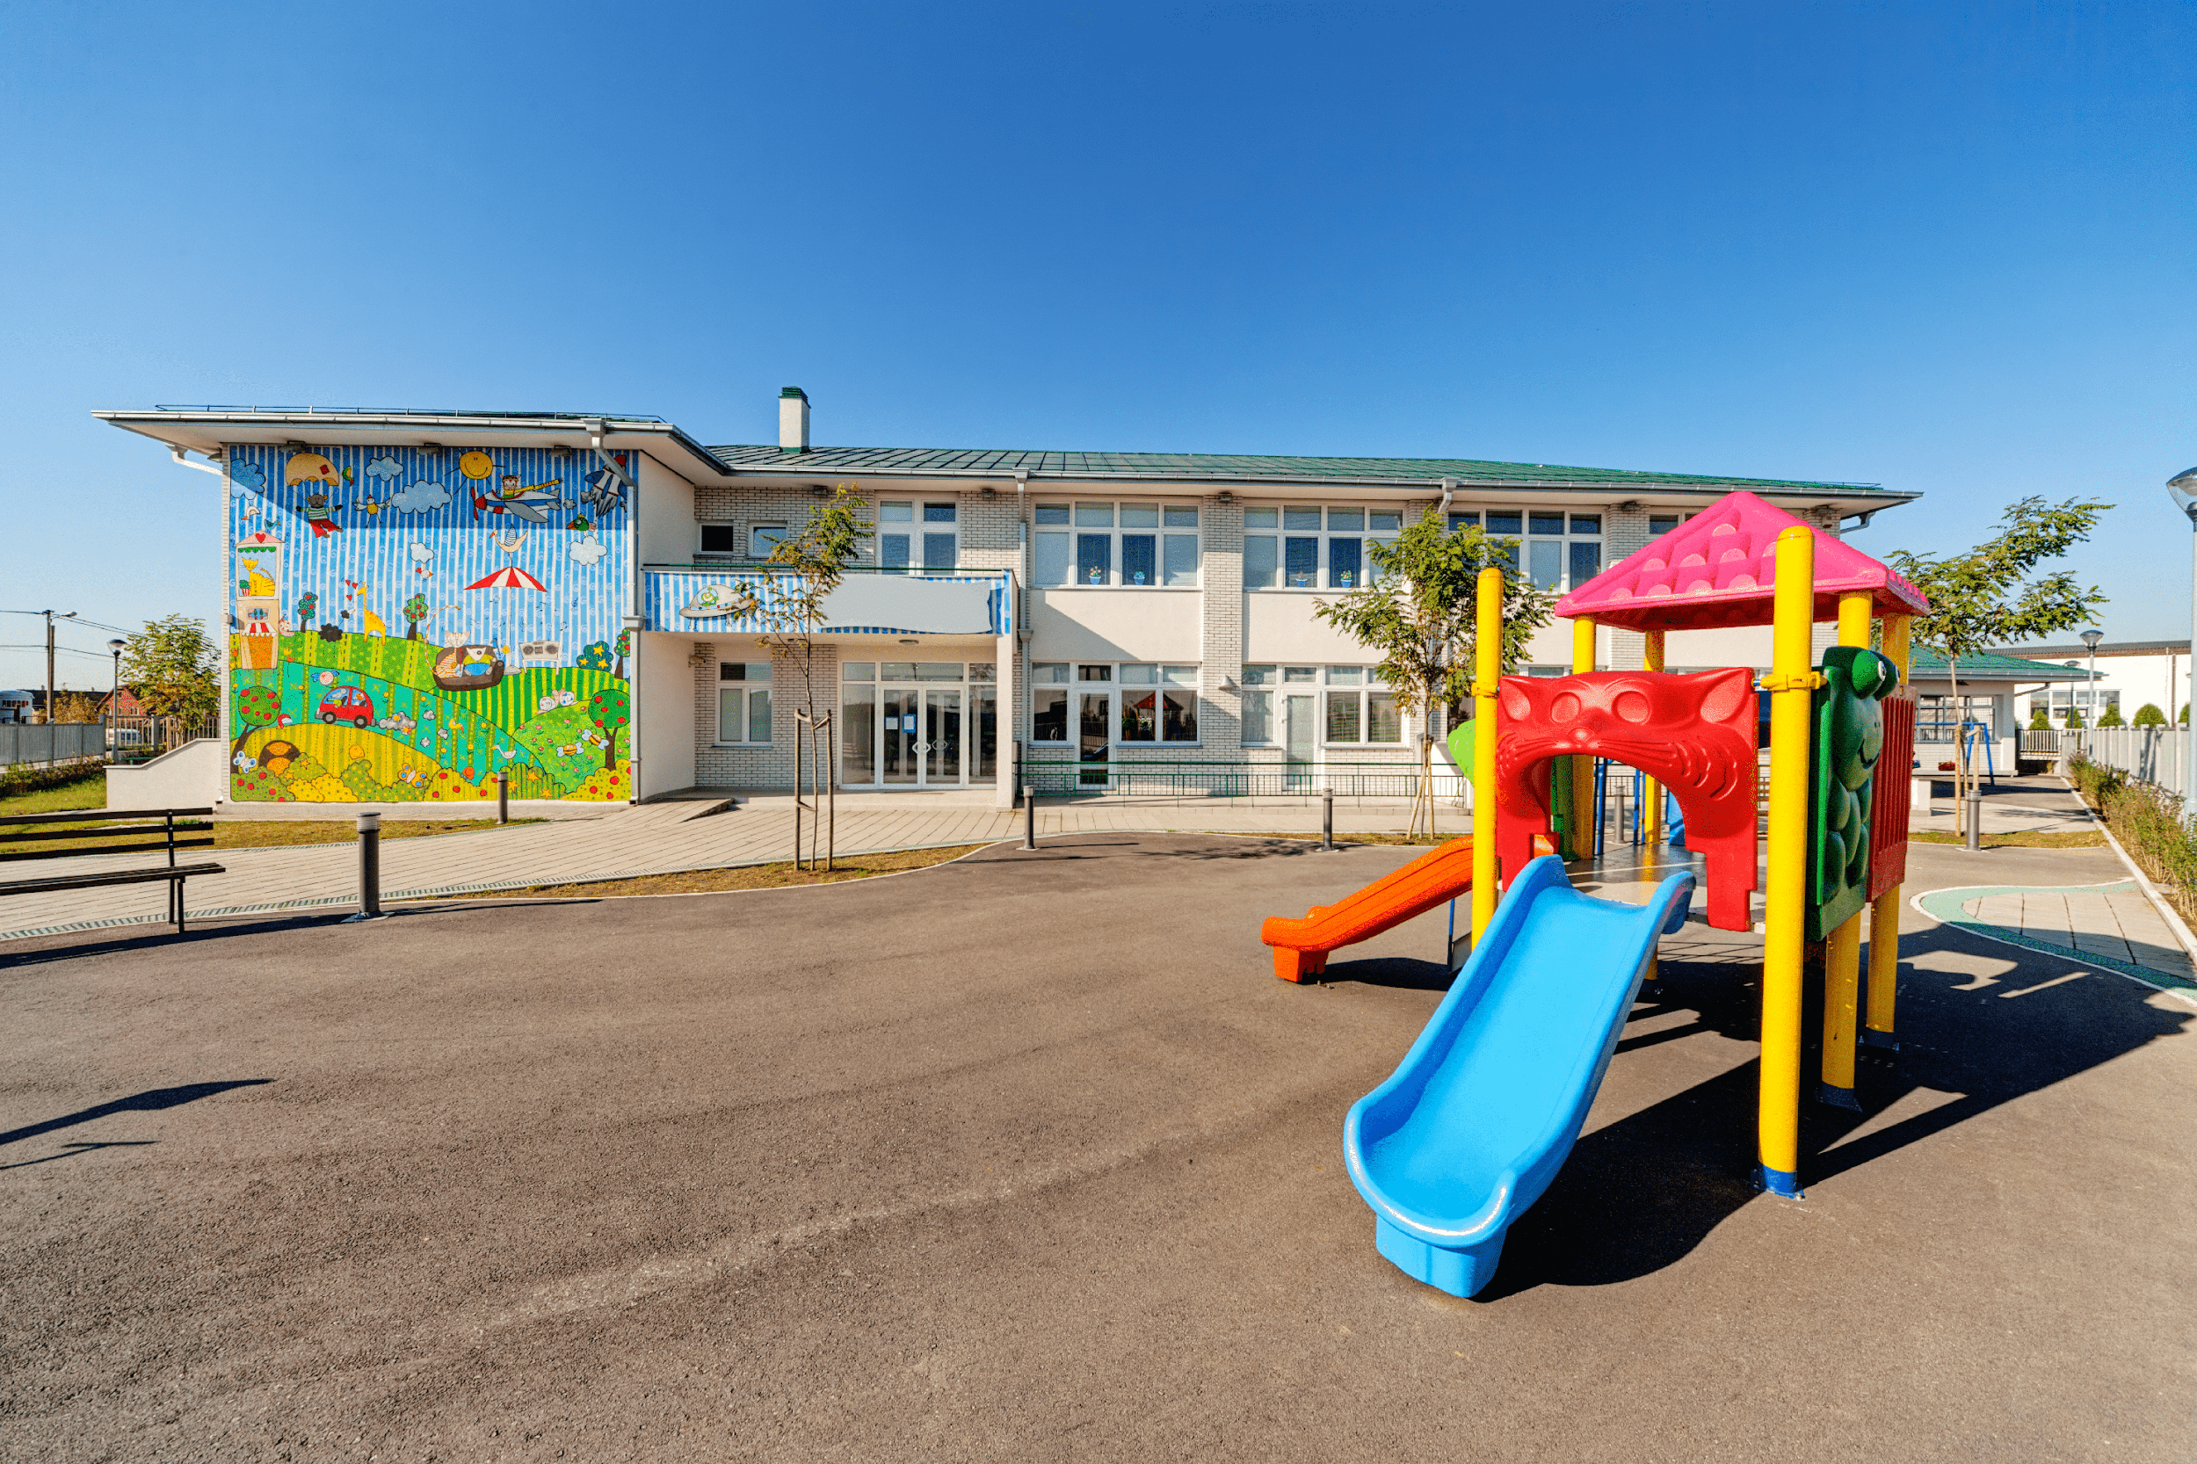
playground

Slide 9
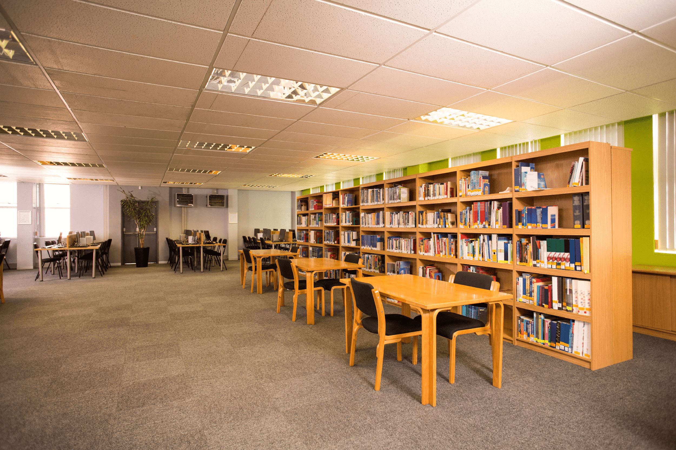
library

Slide 10
Look and guess.

Slide 11
playground

Slide 12
classroom

Slide 13
library

Slide 14
school

Slide 15

Look, listen and repeat.

Slide 16
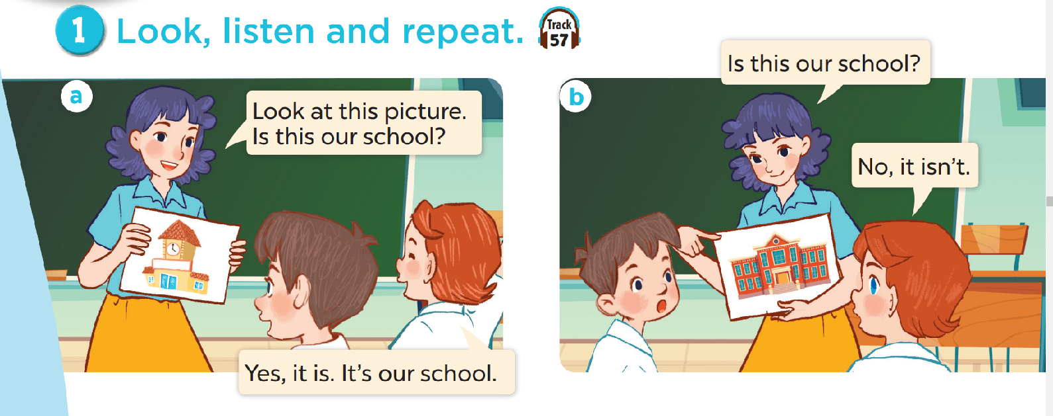
Look and answer the questions.
Where are they?
Who are they?
What are they doing?

Slide 17
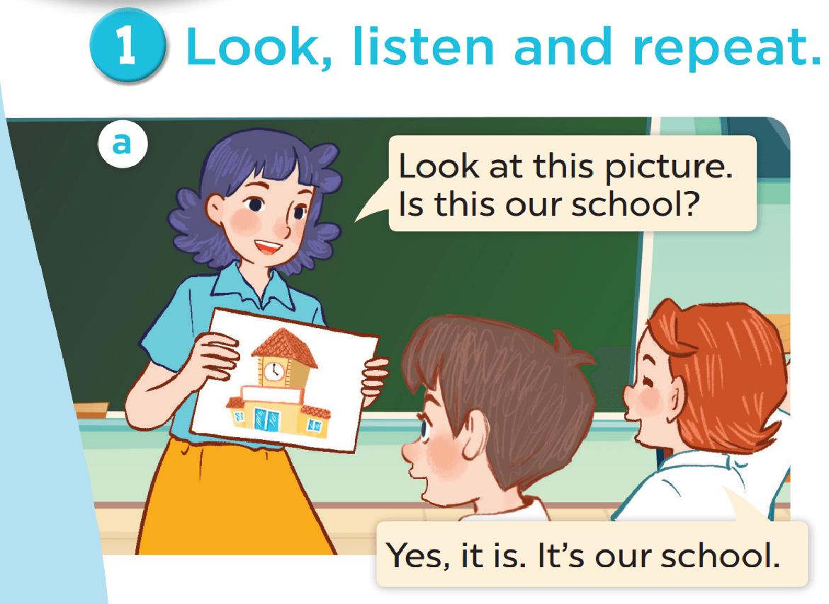

Slide 18
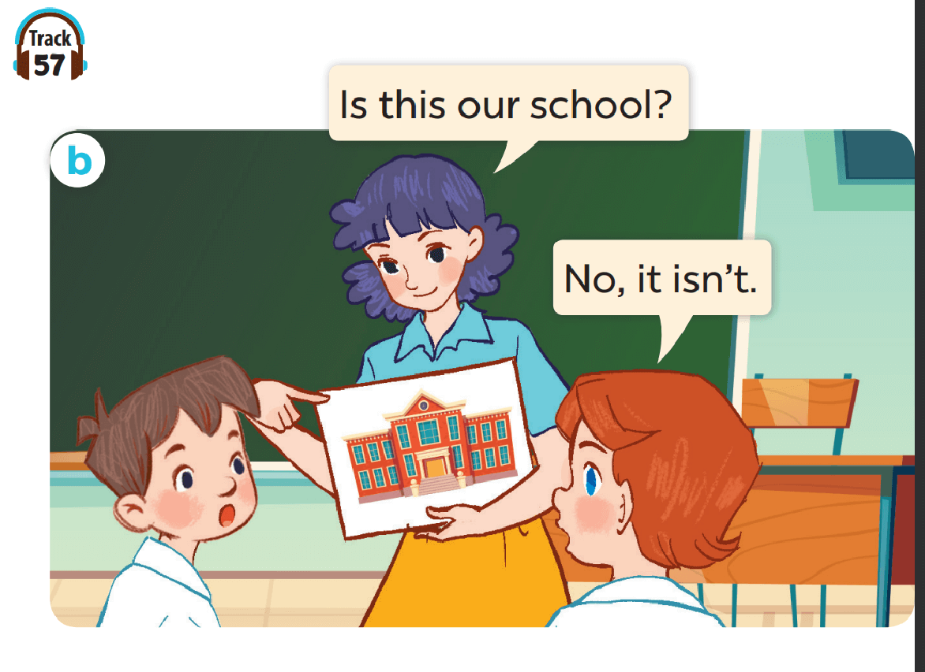

Slide 19

Work in pairs. Practise.
Listen and repeat.

Slide 20

Listen, point and say.

Slide 21



Is this our classroom?
Yes, it is.
No, it isn’t.

Slide 22
Is this our library?
Yes, it is.
No, it isn’t.

Slide 23
Is this our playground?
Yes, it is.
No, it isn’t.

Slide 24
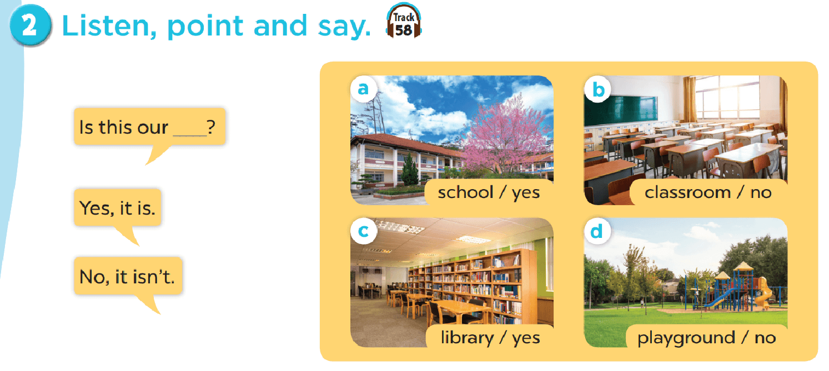
Work in pairs. Practise.

Slide 25

Let’s talk.

Slide 26
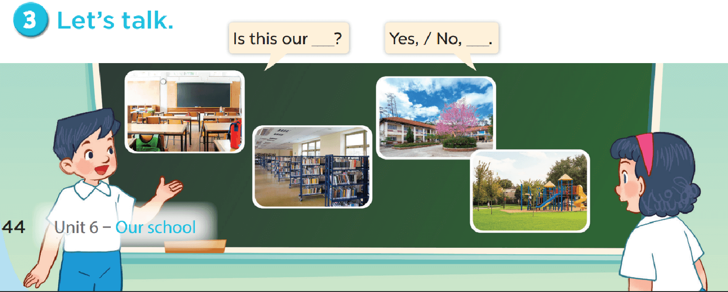

Slide 27

Fun corner

Slide 28
Let’s play a game.
No
Yes
classroom
10 points
No
4
library
5 points
3 points
2
bomb
1
Yes
3
playground
school
school
10 points
school
5
library
- 3 points
6
Yes
1 point
Yes
7
playground
No
Yes
4 points
10 points
8
Notes:
Gv chia 2 đội.
Hs chọn số, 1 bạn đặt câu hỏi, 1 bạn trả lời với từ cho sẵn và nhận điểm

