Slide 1




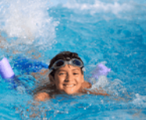



5
My hobbies
LESSON 3
Period 5

Slide 2
Content
1
5
Warm-up
Fun corner and Wrap-up.
4
2
3
Let’s chant.
Listen and repeat.
Listen and circle.

Slide 3


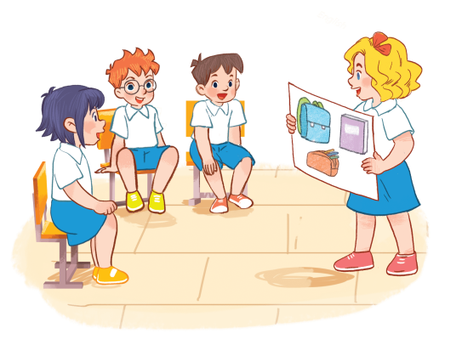

1
Warm-up
Game
Notes:
– Greet the class. Divide the class into two groups to take turns to sing the song
My hobby on page 37. One group sings the first verse. The other sings the
second verse.
-T asks pupils to write 1 hobby on their board and when they hear the word of their hobby in the song, they will stand up and raise their board.

Slide 4
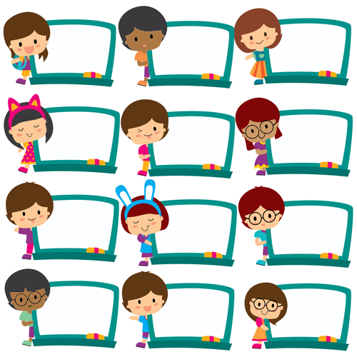
dancing
cooking
painting
swimming
dancing
painting
cooking
cooking
dancing
dancing
swimming
swimming
Notes:
– Greet the class. Divide the class into two groups to take turns to sing the song
My hobby on page 37. One group sings the first verse. The other sings the
second verse.
- T asks pupils to write 1 hobby on their board and when they hear the word of their hobby in the song, they will stand up and raise their board.

Slide 5
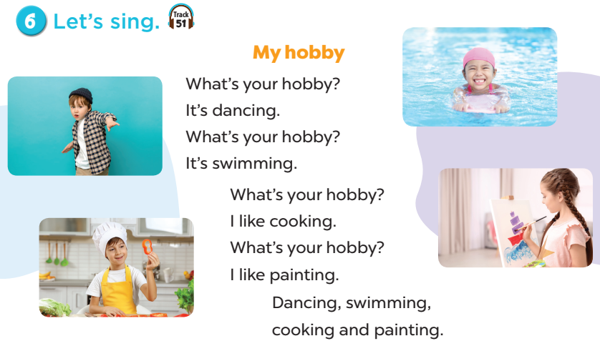

Notes:
– Greet the class. Divide the class into two groups to take turns to sing the song
My hobby on page 37. One group sings the first verse. The other sings the
second verse.
-T asks pupils to write 1 hobby on their board and when they hear the word of their hobby in the song, they will stand up and raise their board.

Slide 6
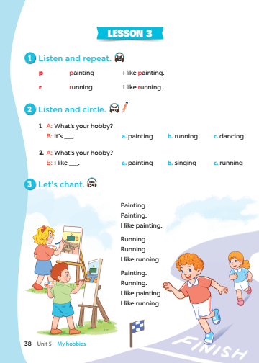
Notes:
T asks pupils to open their SB/38

Slide 7
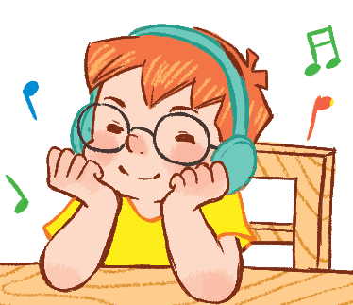
2
Listen and repeat.
Notes:
Step 1: Draw pupils’ attention to the letter p, the word painting and the sentence I like painting.
Play the recording and encourage pupils to point to the letter / word / sentence while listening.
Step 2: Play the recording again for pupils to listen and repeat. Do this several times until
pupils feel confident. Correct their pronunciation where necessary and praise them if their
pronunciation is good.
Step 3: Repeat Steps 1 and 2 for the letter r.

Slide 8
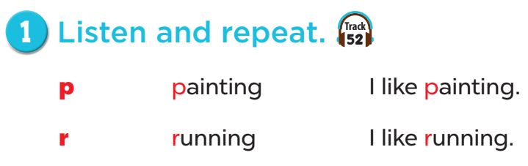
Notes:
Step 1: Draw pupils’ attention to the letter p, the word painting and the sentence I like painting.
Play the recording and encourage pupils to point to the letter / word / sentence while listening.
Step 2: Play the recording again for pupils to listen and repeat. Do this several times until
pupils feel confident. Correct their pronunciation where necessary and praise them if their
pronunciation is good.
Step 3: Repeat Steps 1 and 2 for the letter r.

Slide 9
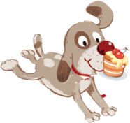
3 listen and circle.
Notes:
Step 1: Draw pupils’ attention to the exchanges and the answer options. Tell pupils about the
activity. Play the recording for pupils to listen. Play the recording again for them to do the task.
Play the recording a third time for them to check the answers.
Step 2: Tell pupils to swap books with a partner then check the answers as a class. Write the
correct answers on the board for pupils to correct their answers.
Step 3: Play the recording again for pupils to check their answers again.
Extension: Invite one or two pupils to stand up, listen to and repeat the exchanges.

Slide 10
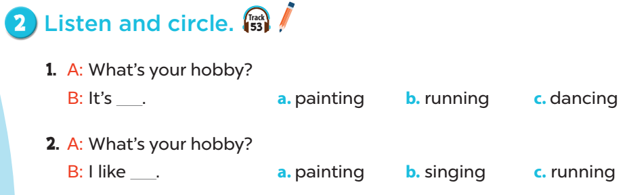
Notes:
Step 1: Draw pupils’ attention to the exchanges and the answer options. Tell pupils about the
activity. Play the recording for pupils to listen. Play the recording again for them to do the task.
Play the recording a third time for them to check the answers.
Step 2: Tell pupils to swap books with a partner then check the answers as a class. Write the
correct answers on the board for pupils to correct their answers.
Step 3: Play the recording again for pupils to check their answers again.
Extension: Invite one or two pupils to stand up, listen to and repeat the exchanges.

Slide 11
Game time
Notes:
Game: Matching
-T divides class into 2 teams(Boys and Girls).
-Pupils in 2 teams take turn to open the boxes to match the questions and answers to their pictures.(open: click the numbers-close: click the red signs)
-Pupils of each team will get points if their matching is correct.
-Review hobbies: painting, cooking, running, walking, singing, swimming.

Slide 12

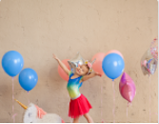
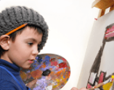


HOBBIES

Slide 13


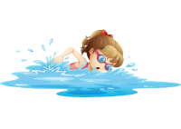




1
2
3
What’s your hobby?
It’s running.
What’s your hobby?
I like singing.
4
5
6
What’s your hobby?
It’s swimming.
7
8
9
What’s your hobby?
I like walking.
10
11
12
What’s your hobby?
It’s painting.
What’s your hobby?
I like cooking.
Notes:
Game: Matching
- T divides class into 2 teams (Boys and Girls).
- Pupils in 2 teams take turn to open the boxes to match the questions and answers to their pictures (open: click the numbers-close: click the red signs).
- Pupils of each team will get points if their matching is correct.
- Review hobbies: painting, cooking, running, walking, singing, swimming.

Slide 14
4
Let’s chant.
Notes:
Step 1: Draw pupils’ attention to the lyrics of the chant. Check comprehension.
Step 2: Play the recording all the way through. Encourage pupils to listen carefully to the
rhythm and pronunciation. Draw pupils' attention to the sounds of the consonants p and r.
Step 3: Play the recording line by line for pupils to listen and repeat. Correct their
pronunciation where necessary.
Step 4: Play the recording all the way through for pupils say the chant. Draw their attention to the
consonant sounds /p/ and /r/ in the words painting and running.
Extension: Divide the class into two or more groups to take turns to listen to and repeat the
chant, while the rest of the class claps along.

Slide 15
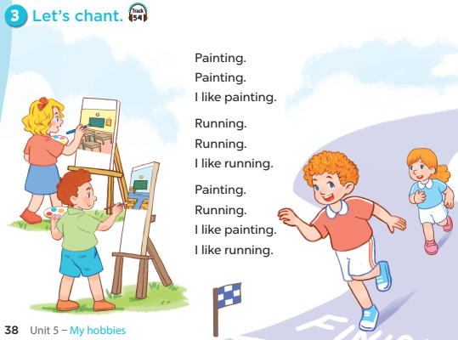
Notes:
Step 1: Draw pupils’ attention to the lyrics of the chant. Check comprehension.
Step 2: Play the recording all the way through. Encourage pupils to listen carefully to the
rhythm and pronunciation. Draw pupils' attention to the sounds of the consonants p and r.
Step 3: Play the recording line by line for pupils to listen and repeat. Correct their
pronunciation where necessary.
Step 4: Play the recording all the way through for pupils say the chant. Draw their attention to the
consonant sounds /p/ and /r/ in the words painting and running.
Extension: Divide the class into two or more groups to take turns to listen to and repeat the
chant, while the rest of the class claps along.

Slide 16
5
Fun corner and
Wrap-up
Notes:
-T divides class into 2 teams(Boys and Girls).
-Pupils in 2 teams listen to the recording spelling of hobbies
-Pupils of each team will get points if they choose correct answers.
-Review hobbies: painting, cooking, running, walking, singing, swimming.

Slide 17


SPELLING HOBBIES
Notes:
Game: Spelling
-T divides class into 2 teams(Boys and Girls).
-Pupils in 2 teams listen to the recording spelling of hobbies
-Pupils of each team will get points if they choose correct answers.
-Review hobbies: painting, cooking, running, walking, singing, swimming.

Slide 18
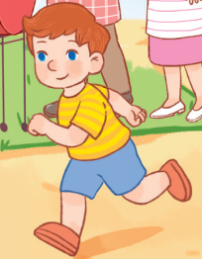
How do you spell this hobby?
Click here
r u n n i n g
w a l k i n g
c o o k i n g
NEXT

Slide 19
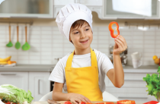
How do you spell this hobby?
Click here
d a n c i n g
s w i m m i n g
c o o k i n g
NEXT

Slide 20
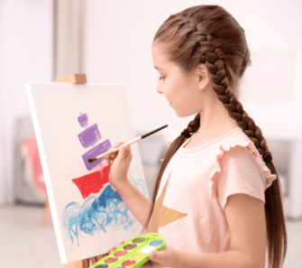
How do you spell this hobby?
Click here
p a i n t i n g
s i n g i n g
d r a w i n g
NEXT

Slide 21

How do you spell this hobby?
Click here
d a n c i n g
r u n n i n g
c o o k i n g
NEXT

Slide 22

How do you spell this hobby?
Click here
p a i n t i n g
d a n c i n g
s i n g i n g
NEXT

Slide 23
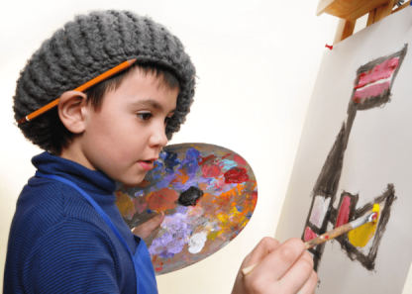
How do you spell this hobby?
Click here
d a n c i n g
d r a w i n g
w a l k i n g
NEXT

Slide 24
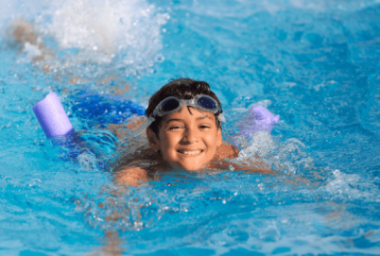
How do you spell this hobby?
Click here
w a l k i n g
s i n g i n g
s w i m m i n g
NEXT

Slide 25
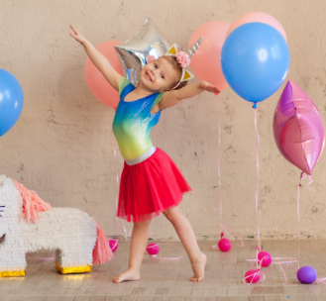
How do you spell this hobby?
Click here
p a i n t i n g
d a n c i n g
c o o k i n g
NEXT

Slide 26


Notes:
T shows 4 pictures on the board and asks pupils to repeat -> Wrap up

