Slide 1








5
My hobbies
LESSON 1
Period 2

Slide 2
Content
1
5
Warm-up
Fun corner and Wrap-up.
4
2
3
Let’s play.
Listen and number.
Read and match.

Slide 3
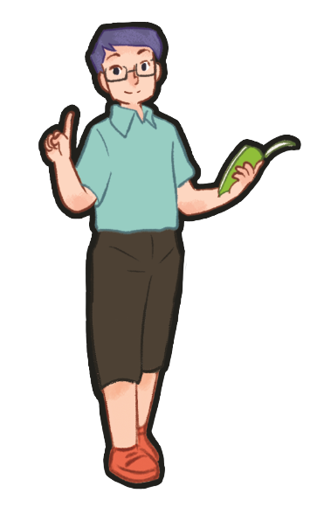
1
Warm-up
Game
Notes:
T asks 2 pupils to come to the board, look at the pictures and repeat the hobbies in the pictures.
T says out loud the word of 1 picture and 2 pupils use the sticks to slap the board choosing the correct picture. (T calls 5 pairs)
T lets the pupils to ask and answer using: What’s your hobby?- It’s _____. (1 pupil uses the stick to point to the picture and asks, the other answer.

Slide 4


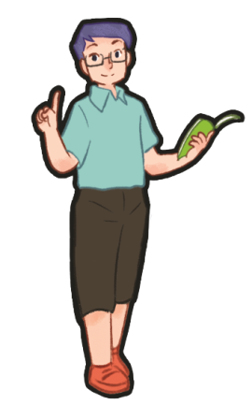





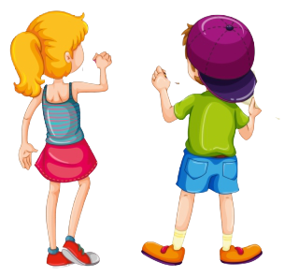
dancing
Notes:
T asks 2 pupils to come to the board, look at the pictures and repeat the hobbies in the pictures.
T says out loud the word of 1 picture and 2 pupils use the sticks to slap the board choosing the correct picture.(T calls 5 pairs)

Slide 5
What’s your hobby?
It’s singing.
Notes:
T lets the pupils to ask and answer using: What’s your hobby? - It’s ___. (1 pupil uses the stick to point to the picture and asks, the other answer.

Slide 6

What’s your hobby?
It’s dancing.
Notes:
T lets the pupils to ask and answer using: What’s your hobby? - It’s ____. (1 pupil uses the stick to point to the picture and asks, the other answer.)

Slide 7
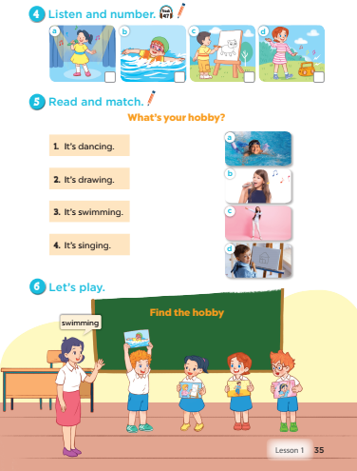
Notes:
T asks sts to open their SB/35.

Slide 8
2
LISTEN AND NUMBER.
Notes:
Step 1: Draw pupils’ attention to the pictures. Tell them about this activity. Elicit the name
of hobby in each picture and give feedback. Play the recording for pupils to listen. Play the
recording again for pupils to do the task. Play the recording a third time to give them another
listening opportunity.
Step 2: Tell pupils to swap books with a partner, then check answers as a class. Write the
correct answers on the board for pupils to correct their answers.
Step 3: Play the recording again for pupils to double-check their answers.

Slide 9
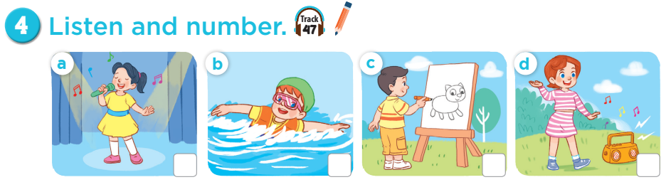

Notes:
Step 1: Draw pupils’ attention to the pictures. Tell them about this activity. Elicit the name
of hobby in each picture and give feedback. Play the recording for pupils to listen. Play the
recording again for pupils to do the task. Play the recording a third time to give them another
listening opportunity.
Step 2: Tell pupils to swap books with a partner, then check answers as a class. Write the
correct answers on the board for pupils to correct their answers.
Step 3: Play the recording again for pupils to double-check their answers.

Slide 10
Let’s check!
Let’s check!
4
3
2
1
Notes:
Step 1: Draw pupils’ attention to the pictures. Tell them about this activity. Elicit the name
of hobby in each picture and give feedback. Play the recording for pupils to listen. Play the
recording again for pupils to do the task. Play the recording a third time to give them another
listening opportunity.
Step 2: Tell pupils to swap books with a partner, then check answers as a class. Write the
correct answers on the board for pupils to correct their answers.
Step 3: Play the recording again for pupils to double-check their answers.

Slide 11
3
READ AND MATCH.
Notes:
Step 1: Draw pupils' attention to the question, the four sentences and the pictures. Tell them
about the activity and give pupils an example by getting them to read the question and
Sentence 1 in chorus. Draw a line to match it with the picture of the girl dancing.
Step 2: Give pupils time to match Sentences 2, 3 and 4 individually. Check answers as a class.
Extension: Invite a few pupils to stand up and read the sentences aloud. Correct their
pronunciation where necessary, praise them, and get the class to clap or cheer if they have
good pronunciation.

Slide 12
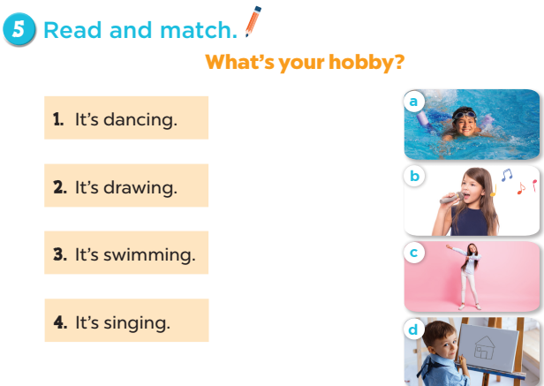
Notes:
Step 1: Draw pupils' attention to the question, the four sentences and the pictures. Tell them
about the activity and give pupils an example by getting them to read the question and
Sentence 1 in chorus. Draw a line to match it with the picture of the girl dancing.
Step 2: Give pupils time to match Sentences 2, 3 and 4 individually. Check answers as a class.
Extension: Invite a few pupils to stand up and read the sentences aloud. Correct their
pronunciation where necessary, praise them, and get the class to clap or cheer if they have
good pronunciation.

Slide 13
4
Let’s PLAY.
Notes:
Step 1: Tell pupils the goal of the game and how to play it. Four pupils hold different flash cards
(Flash card 1: swimming, Flash card 2: drawing; Flash card 3: dancing; Flash card 4: singing).
Step 2: Invite four pupils to the front of the class to demonstrate how to play the game.
Step 3: Teacher shouts out "swimming", the pupil with the swimming flash card steps up and
shows his / her flash card to the whole class.
Step 4: Repeat the procedure with other flash cards. If a pupil fails to show up his / her flash
card or shows up the wrong flash card, he / she is "out" of the game.

Slide 14
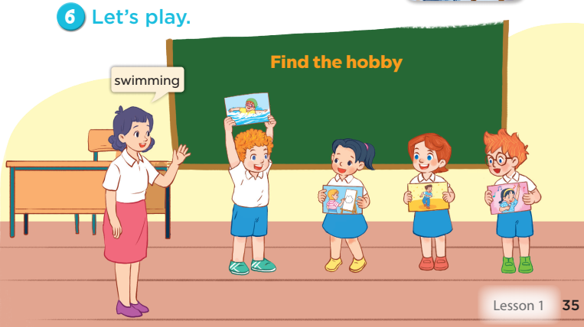
Notes:
Step 1: Tell pupils the goal of the game and how to play it. Four pupils hold different flash cards
(Flash card 1: swimming, Flash card 2: drawing; Flash card 3: dancing; Flash card 4: singing).
Step 2: Invite four pupils to the front of the class to demonstrate how to play the game.
Step 3: Teacher shouts out "swimming", the pupil with the swimming flash card steps up and
shows his / her flash card to the whole class.
Step 4: Repeat the procedure with other flash cards. If a pupil fails to show up his / her flash
card or shows up the wrong flash card, he / she is "out" of the game.

Slide 15
Game time
Notes:
Game: Guessing and Choosing
- T shows 4 pictures of hobbies and calls 4 pupils to come to the board and choose.
- T asks 4 pupils to come to the board and choose 1 picture of hobby and keep them in secret by covering them.
- The others will write their hobbies in the board at their desks and keep their ides in secret.
- The pupils on the board will 1 by 1 show their pictures they chose.
When the teacher says the word of the pictures 1 by 1 shown on the board, who has the same hobby will raise their board or raise their hands.
The pupils on the board will get the same points as the numbers of pupils raising their hands.

Slide 16
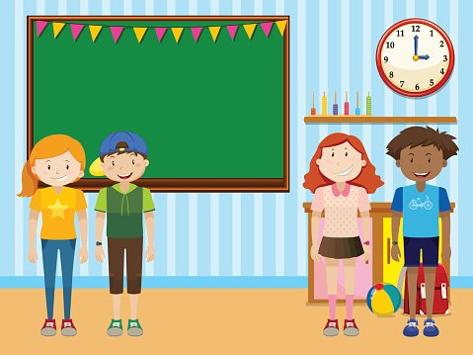

HOBBIES
drawing
swimming
dancing
singing
Notes:
- T shows 4 pictures of hobbies and calls 4 pupils to come to the board and choose.

Slide 17
HOBBIES
drawing
swimming
dancing
singing
Notes:
-T asks 4 pupils to come to the board and choose 1 picture of hobby and keep them in secret by covering them.

Slide 18

singing
dancing
swimming
singing
Notes:
-The others will write their hobbies in the board at their desks and keep their ideas in secret.

Slide 19
HOBBIES
drawing
swimming
dancing
singing
Notes:
-The pupils on the board will 1 by 1 show their pictures they chose.

Slide 20

singing
Notes:
When the teacher says the word of the pictures 1 by 1 shown on the board, who has the same hobby will raise their board or raise their hands.

Slide 21
6 pupils write SINGING
=
6 points
HOBBIES
drawing
swimming
dancing
singing
Notes:
The pupils on the board will get the same points as the numbers of pupils raising their hands.

Slide 22
5
Fun corner and
Wrap-up
Notes:
Matching game:
- T asks 2 pupils to come to the board(boy and girl).
- T asks them to read 4 hobbies on the board.
- T asks them to put the word card matched with the pictures of hobbies.

Slide 23


Notes:
- T asks 2 pupils to come to the board (boy and girl).
- T asks them to read 4 hobbies on the board.
- T asks them to put the word card matched with the pictures of hobbies.

Slide 24
drawing
swimming
drawing
swimming
singing
dancing
singing
dancing
Notes:
The 1st one to match correctly will be the winner.

Slide 25






What’s your hobby?
Notes:
T shows 4 pictures on the board and asks pupils to repeat -> Wrap-up.

