Slide 1








5
My hobbies
LESSON 1
Period 1

Slide 2
Content
1
5
Warm-up
Fun corner and Wrap-up
4
2
3
Let’s talk.
Look, listen and repeat.
Listen, point and say.

Slide 3
1
Warm-up
Let’s play a game.

Slide 4
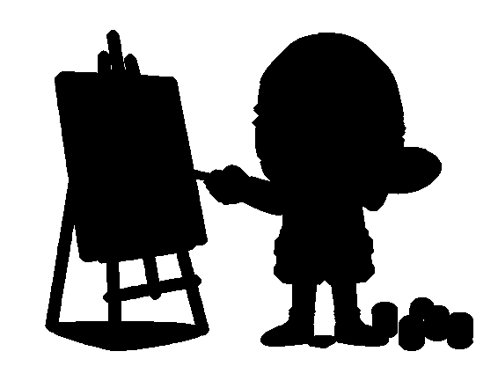



Action simulation
1
2
3
4
Notes:
- T shows picture.
- T asks some sts who can simulate the actions in the pictures through the shadows -> Choose the best ones and gives them points.

Slide 5



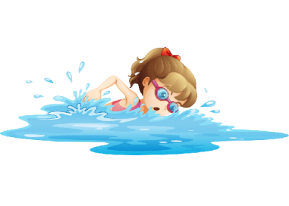


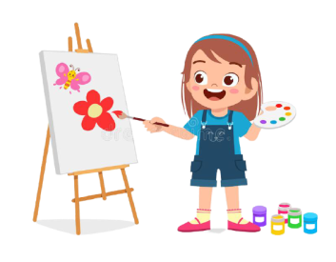
1
2
3
4
a
b
c
d
Notes:
- T asks sts to match the pictures with their shadows in mind first (whole class).
- T says the numbers, sts say the letters -> Check the answers in the next slide.

Slide 6

1
2
3
4
a
d
c
b
Notes:
- T says the numbers 1 by 1 and click to shows the answer.

Slide 7


dancing
Notes:
T shows the shadows with their pictures and say the words and gives sentences: “They are ____.”, “She is _____.”, “He is _____.”.

Slide 8
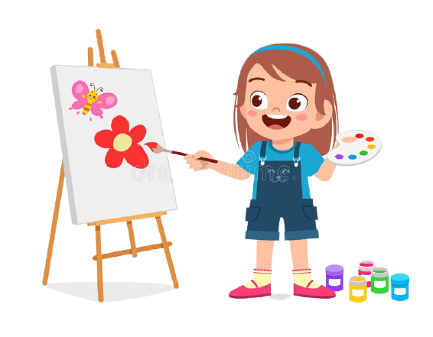
drawing
Notes:
T shows the shadows with their pictures and say the words and gives sentences: “They are ______.”, “She is ______.”, “He is ______.”

Slide 9

singing
Notes:
T shows the shadows with their pictures and say the words and gives sentences: “They are ______.”, “She is ______.”, “He is ______.”

Slide 10


swimming
Notes:
T shows the shadows with their pictures and say the words and gives sentences: “They are ______.”, “She is ______.”, “He is ______.”

Slide 11
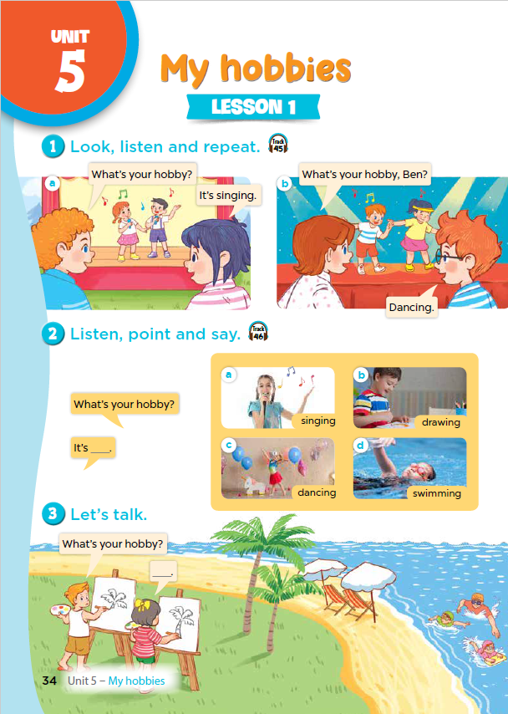
Notes:
T asks sts to open their SB/34.

Slide 12
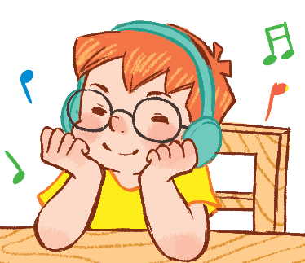
2
Look, listen and repeat.

Slide 13
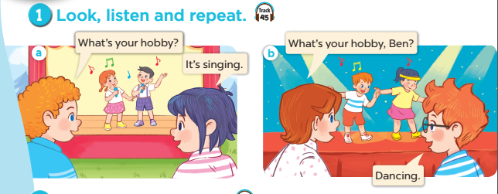

Notes:
Part 1: look listen and repeat.
Step 2: ask pupils to look at context a. play the recording for them to listen. Play the recording again, sentence by sentence, for them to listen and repeat. Correct pronunciation if necessary.
Step 3: do the same with context b
Step 4: Work in pair- role play
Step 5: invite few pairs to the front of the class and act.

Slide 14
2
Listen, point and say.

Slide 15
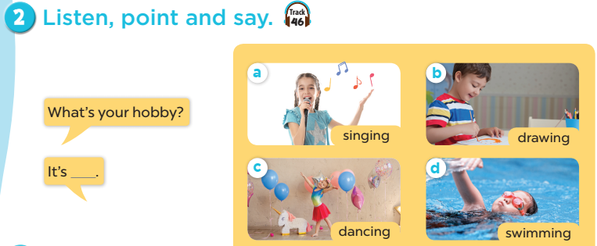
Notes:
Activity 2: point and say:
Step 1: : Have pupils look at the pictures and elicit the names of the students. Have the class repeat the words a few time
Step 2: ask 2 pupils to do as an example.
Step 4: ask pupils to work in pairs, pointing to the questions and pictures and giving the answers
Step 5: Invite few pairs to the front of the class and make questions and answers.

Slide 16

singing

Slide 17
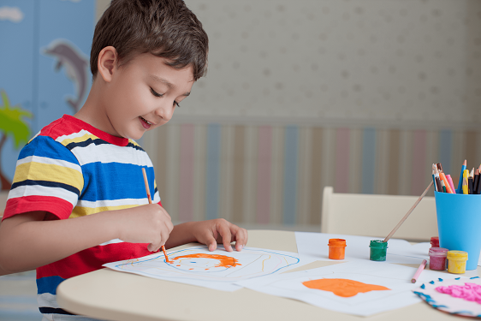
drawing

Slide 18
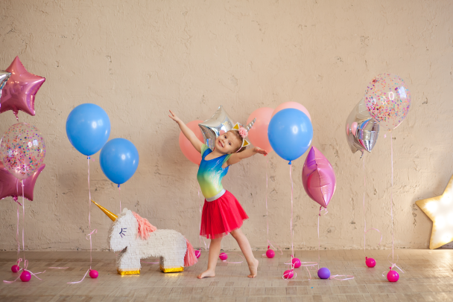
dancing

Slide 19
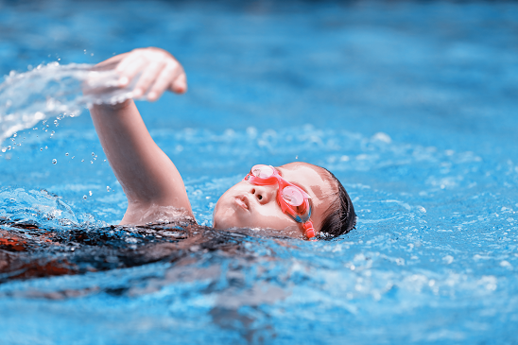
swimming

Slide 20
Notes:
Activity 2: point and say:
Step 1: : Have pupils look at the pictures and elicit the names of the students. Have the class repeat the words a few time
Step 2: ask 2 pupils to do as an example.
Step 4: ask pupils to work in pairs, pointing to the questions and pictures and giving the answers
Step 5: Invite few pairs to the front of the class and make questions and answers.

Slide 21




What’s missing?
Notes:
Game: What’s missing
Divide the class into 4 groups.
A pupil from each group comes to the front, look at the pictures and say which is missing.
Who say it fast will get points.

Slide 22
What’s missing?
Notes:
Game: What’s missing
Divide the class into 4 groups.
A pupil from each group comes to the front, look at the pictures and say which is missing.
Who say it fast will get points.

Slide 23
What’s missing?

Slide 24
What’s missing?

Slide 25
What’s missing?

Slide 26
4
Let’s talk.

Slide 27
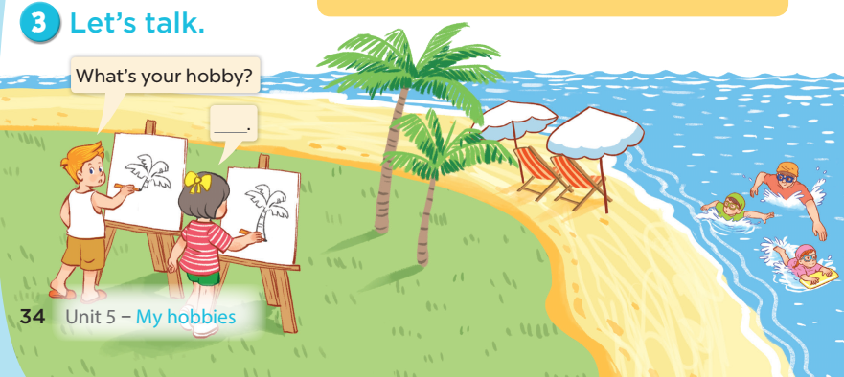

Slide 28


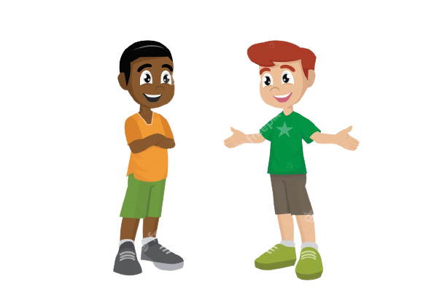
It’s ………..
What’s your hobby?
Notes:
-T asks sts to practice in pairs asking and answering
-T asks some pairs to present in front of class

Slide 29
Game time

Slide 30

HOBBIES
drawing
swimming
dancing
singing
Notes:
-T writes 4 new words on the board and asks sts to read (whole class)
-T asks 4 sts to come to the board and write their hobbies in the pieces of paper and keep them in secret

Slide 31

swimming/ drawing, ..?
dancing/ singing, ..?
dancing/ singing, ...?
swimming/drawing, ...?
HOBBIES
drawing
swimming
dancing
singing
Notes:
-T asks 1 student come to the board and guess their hobbies written in the paper (He has to write the answers in the small pieces of paper and stick to each 4 students

Slide 32

It’s swimming.
HOBBIES
drawing
swimming
dancing
singing
What’s your hobby?
swimming
singing
dancing
drawing
Notes:
T asks the student to ask the question to find the answers and gives him or her point if correct.
(repeat the activities depending the time)

Slide 33
5
Fun corner and
Wrap-up

Slide 34



Notes:
T asks 1 student come to the board and face to the class.
T shows 1 picture of 4 hobbies and lets the others act so that the student on the board can guess the name of the hobby in the picture
(1 student will guess 3 pictures)

Slide 35



What’s your hobby?
Notes:
T shows 4 pictures on the board and asks sts to repeat -> Wrap up

