Slide 1



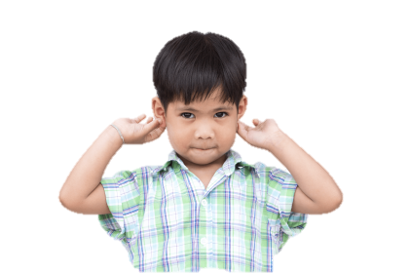


4
Our bodies
LESSON 3
Period 5

Slide 2
Contents
1
2
3
Warm-up and review
Listen and repeat.
4
Fun corner and wrap-up
Listen and circle.
5
Let’s chant.

Slide 3
1
Warm-up and review

Slide 4
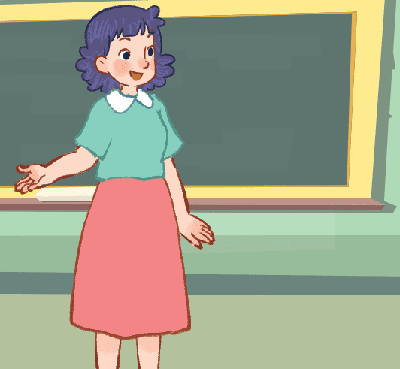
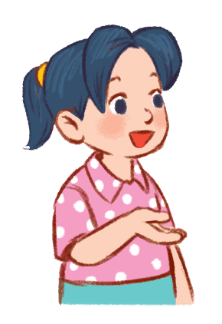
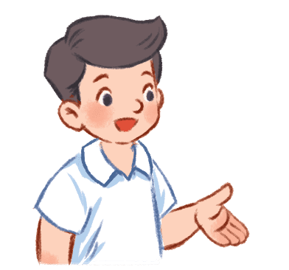


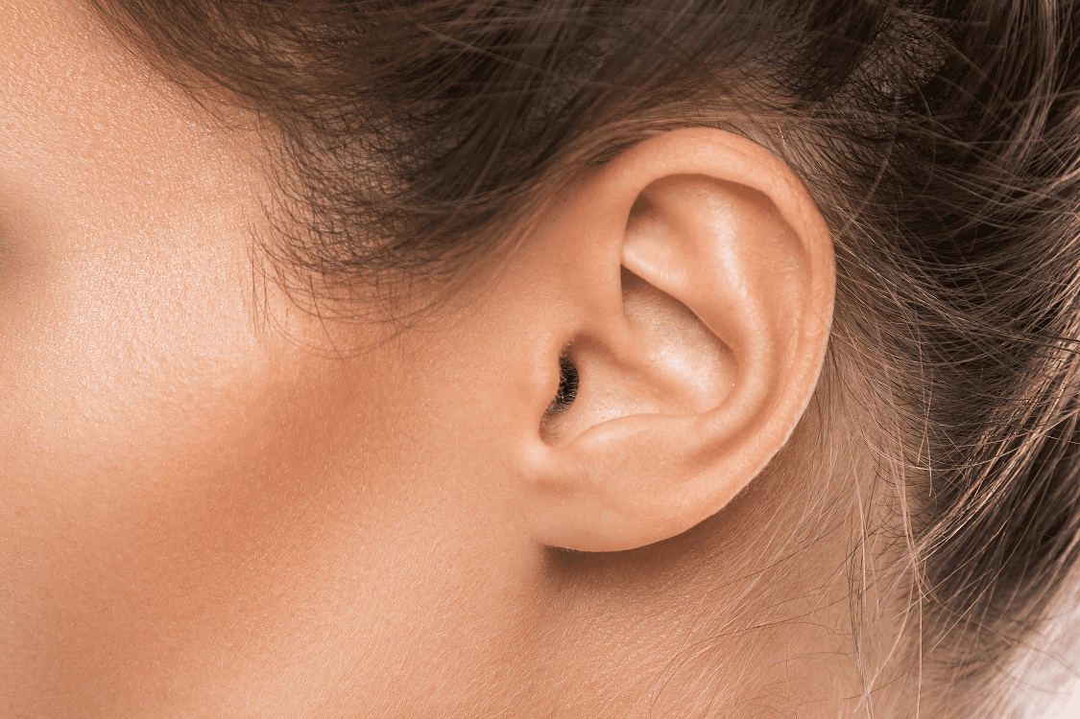
Jump and say.
Notes:
Option 1: Game: Jump and say
Step 1: Ask 5 – 6 pupils to join the game. Line them up. Each pupil holds a flashcard.
Step 2: If the pupils hear that teacher has said the word that matches their flashcard, they must jump and say out loud.

Slide 5
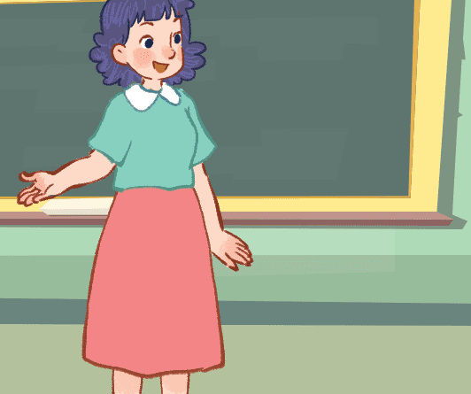


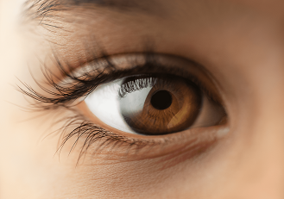
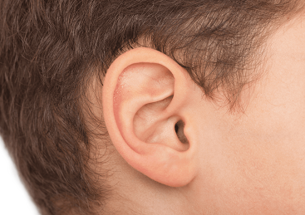
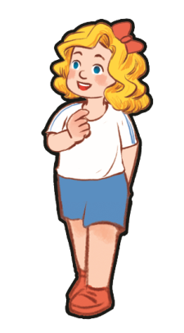
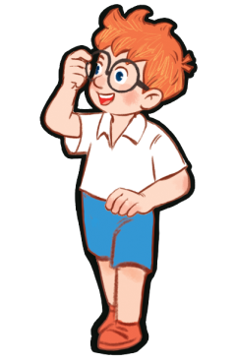
Which is missing?
Notes:
Option 2: Which is missing?
Step 1: Teacher puts four or five flashcards on a board and tells pupils to read out loud.
Step 2: Ask them to close their eyes. Teacher takes one (or two/three picture... depending on the level of your class) item away.
Step 3: Have pupils open their eyes, ask them to guess what item is missing and say that word out loud .

Slide 6
2
Listen and repeat.

Slide 7
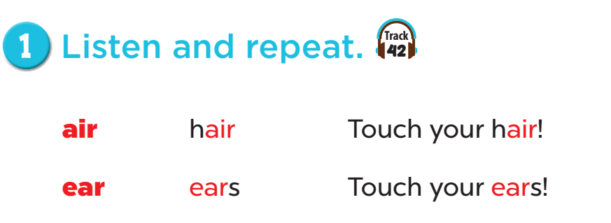


Slide 8
3
Listen and circle.

Slide 9
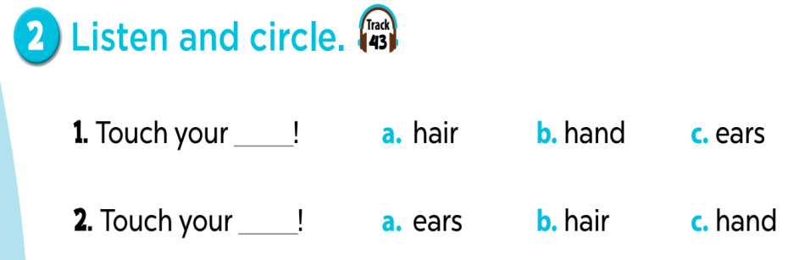
Notes:
Key: 1. c 2. b

Slide 10
4
Let’s chant.

Slide 11
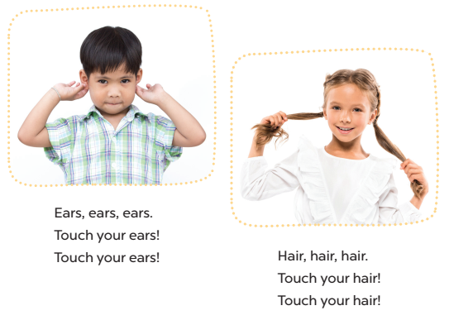

Slide 12
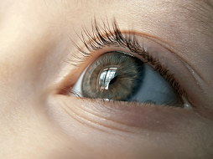
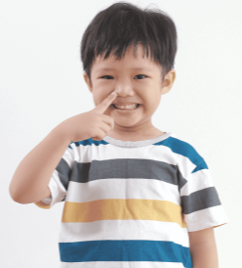
Eyes, eyes, eyes.
Open your eyes!
Open your eyes!
Nose, nose, nose.
Touch your nose!
Touch your nose!
Notes:
Game: Who is the best leader?
- Teacher can change the lyrics of the chant to other body parts.
- Then ask some pupils to do the gesture (touch/ open/ point) while the rest of the class follow along.

Slide 13
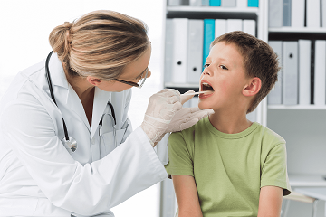

Mouth, mouth, mouth.
Open your mouth!
Open your mouth!
Face, face, face.
Touch your face!
Touch your face!

Slide 14
5
Fun corner and wrap-up

Slide 15


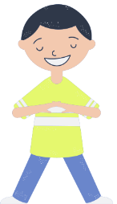
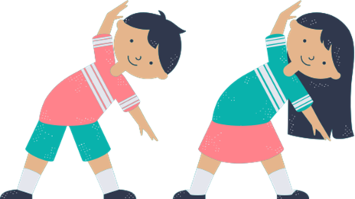
Let’s relax!
Let’s relax!
Notes:
Relax your body
This is a mini exercise for kids to relax after a lesson. Pupils listen and do after teacher.
Shake your hands!
Look around (eyes)!
Open and close your mouth! And smile !
Take a deep breath (nose)!
Comb your hair (by fingers)!
Massage your face!
- Repeat the exercise a few times!

