Slide 1
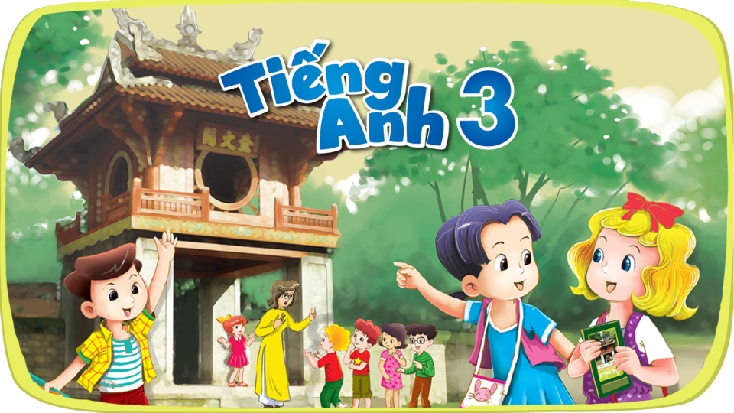


Slide 2



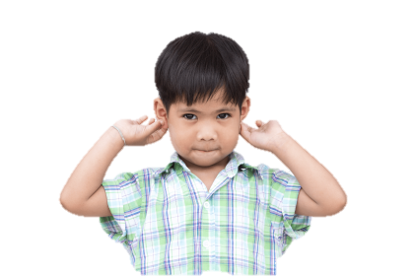


4
Our bodies
LESSON 1
Period 1

Slide 3
Contents
1
Warm-up
4
Let’s talk.
2
Look, listen and repeat.
3
Listen, point and say.
5
Fun corner and wrap-up

Slide 4
1
Warm-up

Slide 5

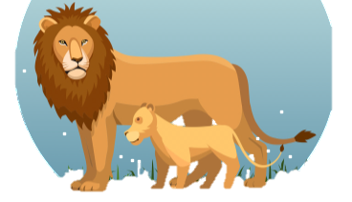
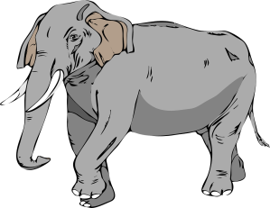

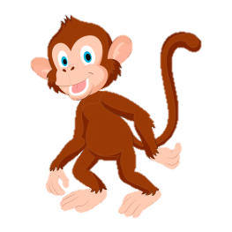
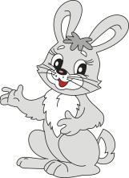


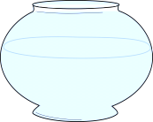




Notes:
Game: Animal and body parts
Step 1: Review the names of 5 animals
Step 2: Teacher gives a question (combined with descriptive gestures): Which animal has ...?
Step 3: Asks pupils to answer which animal is it.

Slide 6
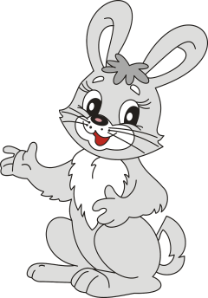
Notes:
Which animal has long ears?
Rabbit – ear.
A rabbit has long ears.

Slide 7


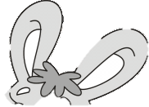
ears
Notes:
A rabbit has long ears.

Slide 8
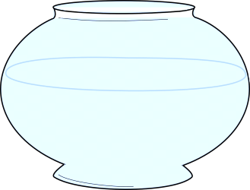

Notes:
Which animal has round eyes?
Fish – eye.

Slide 9

eye
Notes:
A fish has round eyes.

Slide 10

Notes:
Which animal has small hands?
Monkey – hand.

Slide 11


hand
Notes:
A monkey has small hands.

Slide 12
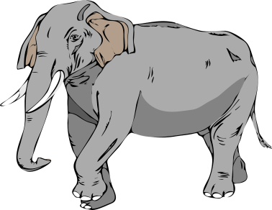
Notes:
Which animal has a long nose?
Elephant – nose.
Elephant has a long nose.

Slide 13
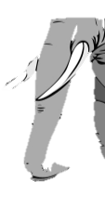
nose
Notes:
Elephant has a long nose

Slide 14
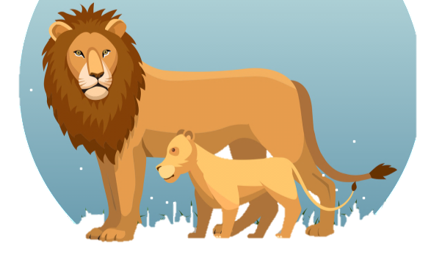
Notes:
Which animal has a big face?
Lion – face.

Slide 15
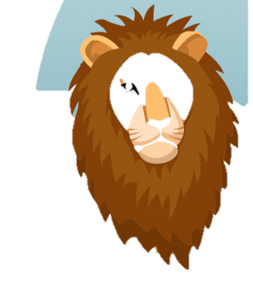
face
Notes:
A lion has a big face.

Slide 16
2
Look, listen and repeat.

Slide 17
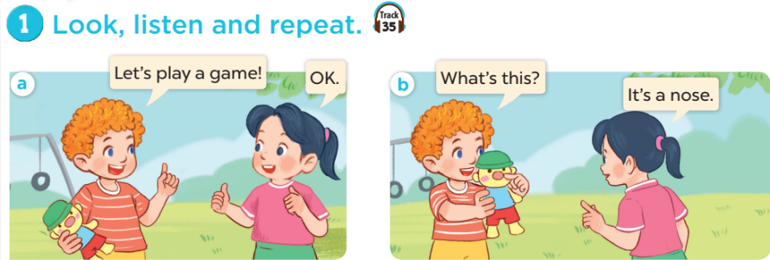

Slide 18
3
Listen, point and say.

Slide 19
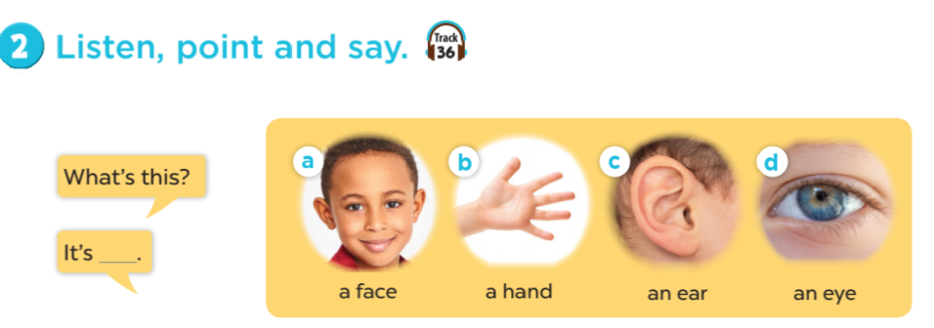

Slide 20
4
Let’s talk.

Slide 21
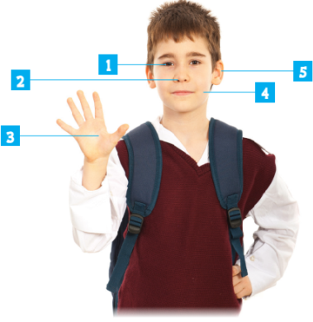
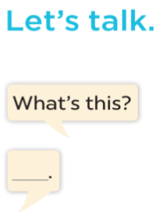

Slide 22

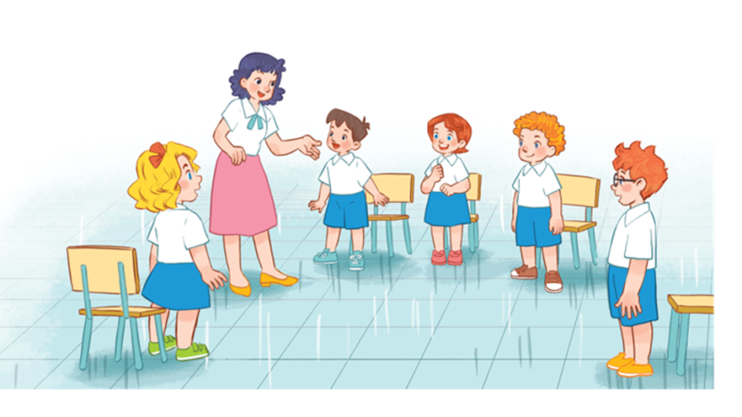

Notes:
Game: Pass the ball!
Goal: To practice asking and answering
Step 1: Divide class into 2 big groups, each group has a ball.
Step 2: While the music plays, pupils pass the ball around the class.
Step 3: When the music stops, the pupil in each group with the ball has to take turns to ask and answer: What’s this? (point to body part). It’s a ___.

Slide 23
5
Fun corner and wrap-up

Slide 24

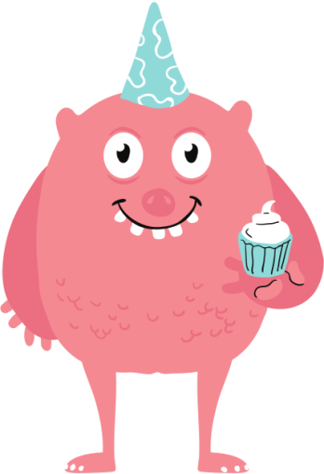



Draw your monster!
Notes:
Game: Draw your monster
- Review the new words.
- Ask students to draw a picture about their favourite monsters (with body parts that they learnt today).
- Then ask students to work with your partners, tell their friends about it.

Slide 25





ear
face
nose
eye
hand

Slide 26
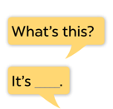
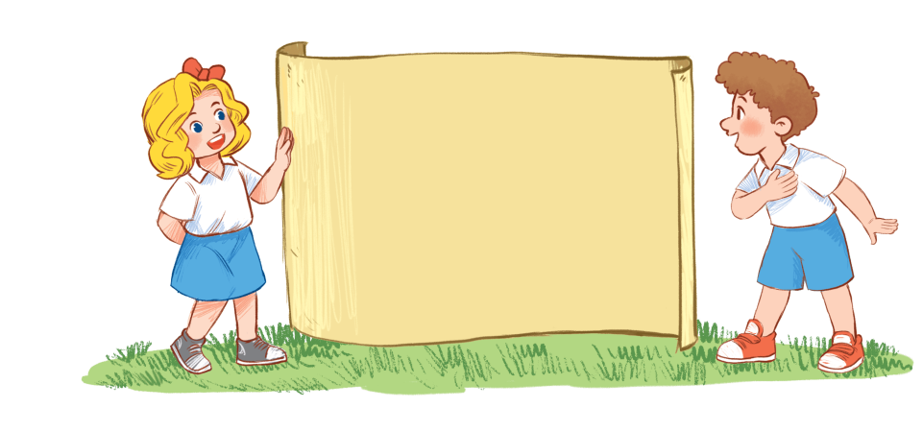
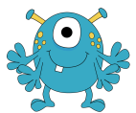

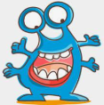
a face
an eye
a hand
an ear
a nose
Notes:
Hình ảnh (free): https://www.seekpng.com/ima/u2w7w7a9a9u2q8i1/

