Slide 1




3
Our friends
LESSON 3 – PERIOD 6

Slide 2


CONTENTS
1
Warm up & Review
2
Read and match.
3
Let’s write.
4
Project
Fun corner & Wrap-up
5
Next
Notes:
G

Slide 3










A
B
Warm-up & Review
1
60
10
70
45
90
30
20
100
35
80
40
50
CLICK THE WHEEL
Notes:
HS chọn con cá mình thích để đi đến câu hỏi, nhấn vào loa để nghe rồi chọn câu trả lời. Nhấn vào nút Home để quay lại vòng quay và nhận điểm.

Slide 4






LISTEN AND CHOOSE THE RIGHT SOUND.
Th
θ
Th
θ
Th
θ
__ - __ank - __ank you, Bill.
th
ð
th
θ

Slide 5


LISTEN AND CHOOSE THE RIGHT SOUND.
th
ð
th
ð
th
ð
__ - __is - Is __is Linh?
th
ð
th
θ

Slide 6


LISTEN AND CHOOSE THE RIGHT SOUND.
th
ð
th
ð
th
ð
__ - __at - Is __at Ben?
th
ð
th
θ

Slide 7

LISTEN AND CHOOSE THE RIGHT SOUND.
Th
θ
Th
θ
Th
θ
___ - __ank - ___ank you, Mai.
th
ð
th
θ

Slide 8

LISTEN AND CHOOSE THE RIGHT SOUND.
Th
ð
__ - __is - __is is Mary.
Th
ð
Th
ð
th
ð
th
θ

Slide 9


LISTEN AND CHOOSE THE RIGHT SOUND.
Th
ð
Th
ð
Th
ð
__ - __at - __at's Lucy.
th
ð
th
θ

Slide 10
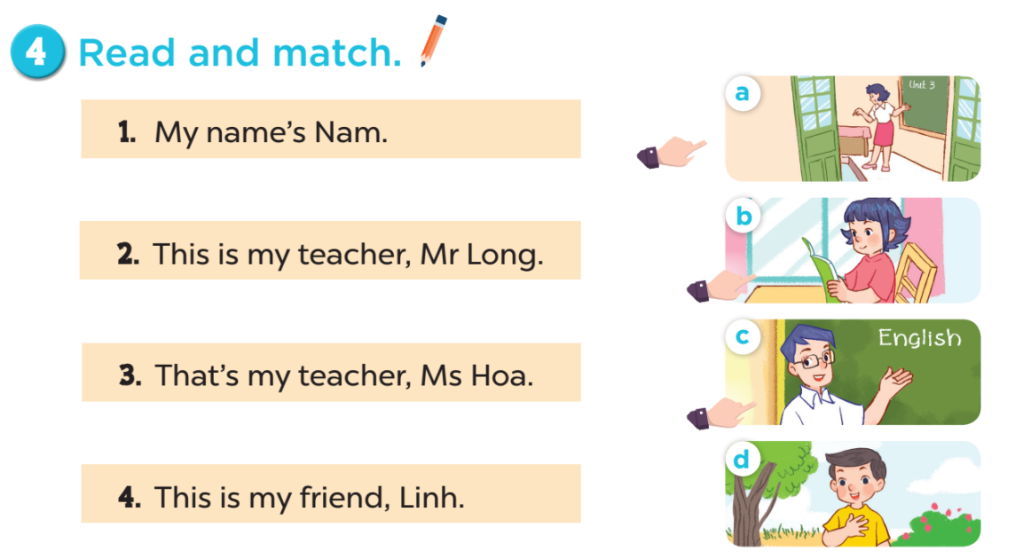

Slide 11
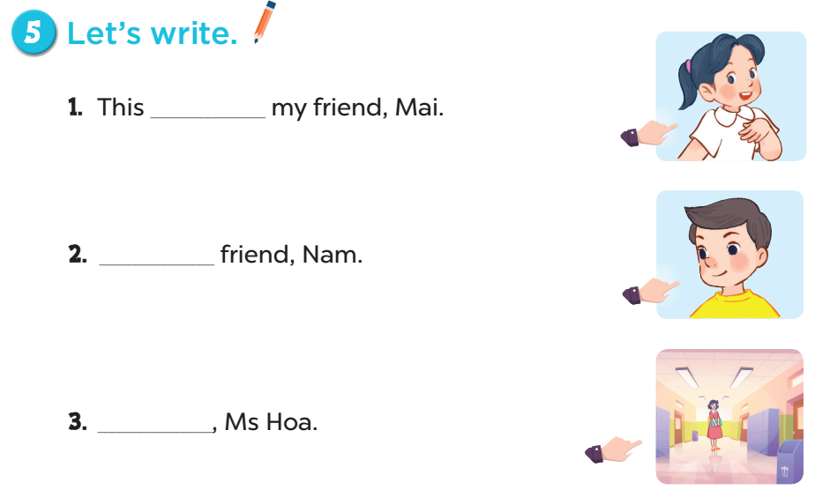

is
This is my
That’s my
teacher

Slide 12


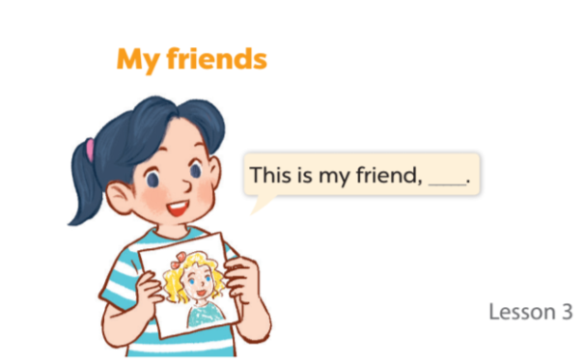


Slide 13



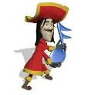





5
Fun corner & Wrap-up
TEAM A
9
9
9
0
1
2
3
4
5
6
7
8
0
1
2
3
4
5
6
7
8
0
1
2
3
4
5
6
7
8
50 points
- 10 points
1
2
TEAM B
10 points
3
4
40 points
9
9
9
0
1
2
3
4
5
6
7
8
0
1
2
3
4
5
6
7
8
0
1
2
3
4
5
6
7
8
30 points
20 points
5
6
Notes:
GV chia lớp thành 2 đội và lần lượt trả lời câu hỏi. Với mỗi đáp án đúng, học sinh được chọn một ô cửa trên tàu và nhận số điểm tương tứng với hình đã chọn.

Slide 14
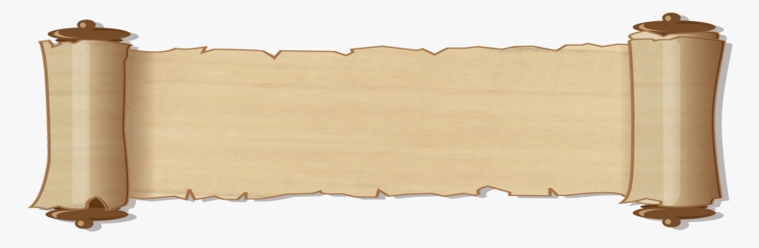
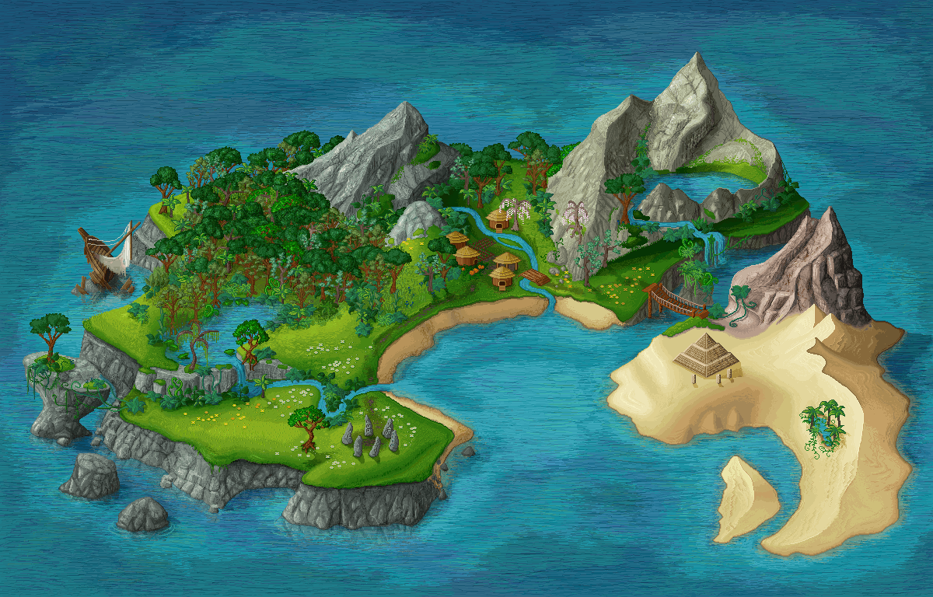





_____my friend, Mary.
This is
This
That’s
This is
NEXT

Slide 15
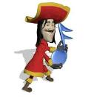


A
B
C
What are on the ship?
Let’s choose one window!

Slide 16



________ friend, Ben.
That is my
This is my
That is my
Is that my
NEXT

Slide 17
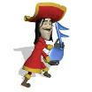

A
B
C
What are on the ship?
Let’s choose one window!

Slide 18


_________friend, Lucy.
This is my
This is my
Is this my
That’s my
NEXT

Slide 19

A
B
C
What are on the ship?
Let’s choose one window!

Slide 20

______ Bill?
Yes, it is.
Is that
This is
Is this
Is that
NEXT

Slide 21
A
B
C
What are on the ship?
Let’s choose one window!

Slide 22


________ friend, Linh.
This is my
This is my
Is this my
That’s
NEXT

Slide 23


A
Bb
Cc
What are on the ship?
Let’s choose one window!

Slide 24

______ friend, Nam.
That is my
This is my
That is my
Is that my
NEXT

Slide 25


A
B
C
What are on the ship?
Let’s choose one window!

