Slide 1




3
Our friends
LESSON 2 – PERIOD 3

Slide 2


CONTENTS
1
Warm up & Review
2
Look, listen ad repeat.
3
Listen, point and say.
4
Let’s talk.
Fun corner & Wrap-up
5
Next
Notes:
G

Slide 3
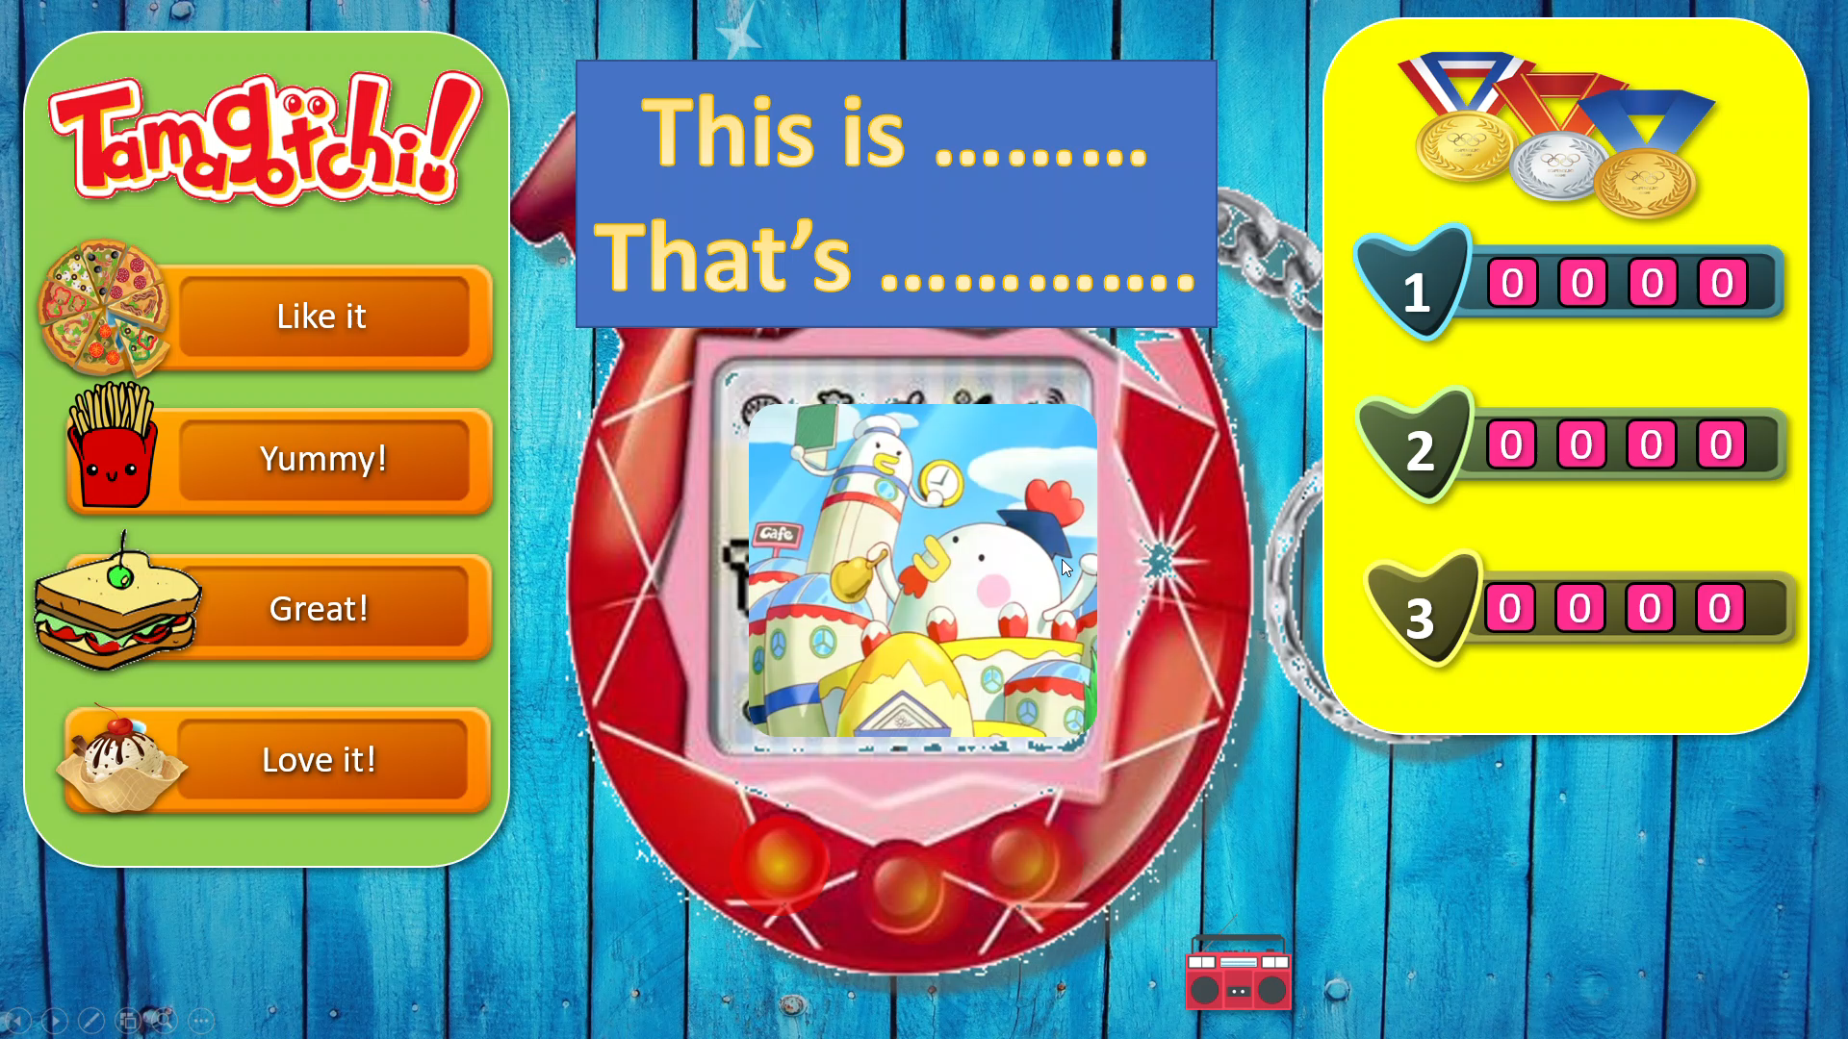

1
Warm-up & Review
Watch this video to see the game rules.
Notes:
Divide the class into three teams. Students choose the food they like. Teacher clicks the food that is chosen. Let student make a sentence with a picture. Give them points if they are right.

Slide 4







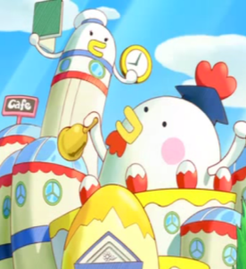



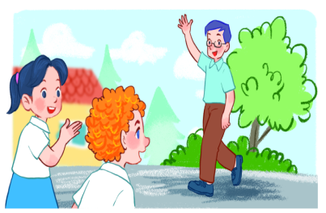
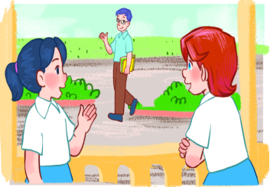
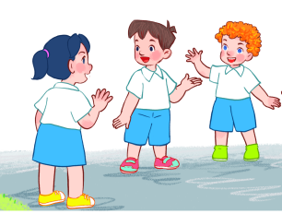



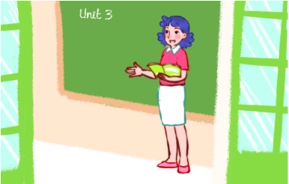
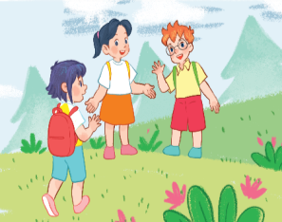












This is ………
That’s ………….
1
9
8
7
6
5
4
3
2
1
0
9
8
7
6
5
4
3
2
1
0
9
8
7
6
5
4
3
2
1
0
9
8
7
6
5
4
3
2
1
0
2
9
8
7
6
5
4
3
2
1
0
9
8
7
6
5
4
3
2
1
0
9
8
7
6
5
4
3
2
1
0
9
8
7
6
5
4
3
2
1
0
17 pts
10 pts
70 pts
30 pts
50 pts
15 pt
40 pts
25 pts
30 pt
20 pts
20 pts
30 pt
10 pts
3
9
8
7
6
5
4
3
2
1
0
9
8
7
6
5
4
3
2
1
0
9
8
7
6
5
4
3
2
1
0
9
8
7
6
5
4
3
2
1
0

Slide 5
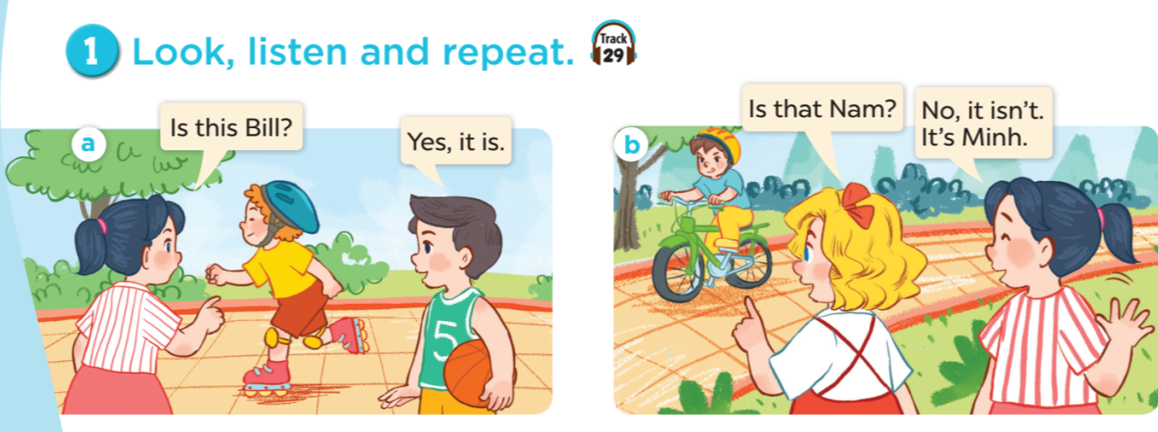

Notes:
G

Slide 6
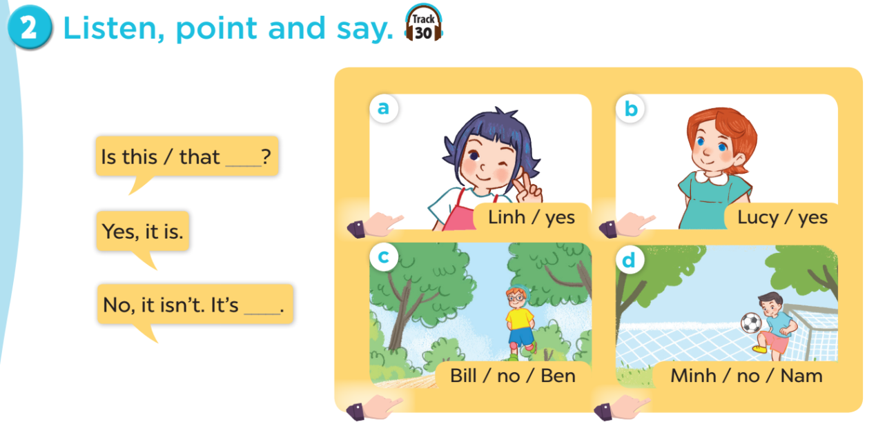

Notes:
G

Slide 7
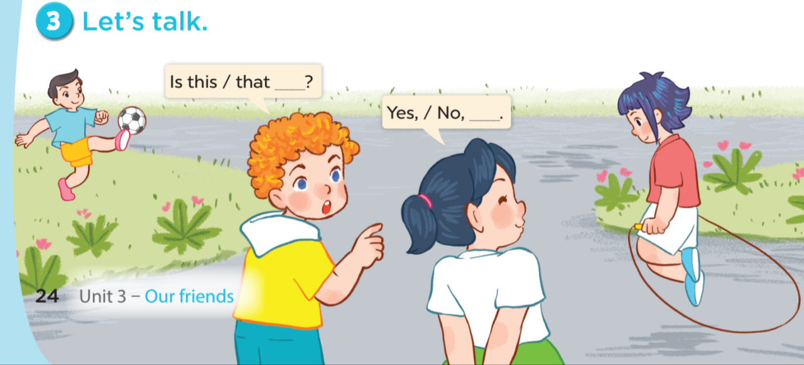
Notes:
G

Slide 8









A
B
Fun corner & Wrap-up
5
1
3
2
4
5
8
6
7
Notes:
Divide the class into 2 teams. Have the teams take turns to choose numbers. Teachers clicks the chosen numbers to go to the questions. For each correct answer, pupils choose a number to get their points. The team with more points will be the winner.

Slide 9
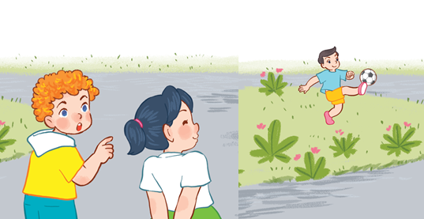

Is that Minh?
A
Yes, it is.
No, it isn’t.
B

Slide 10


Is this Linh?
A
Yes, it is.
No, it isn’t.
B

Slide 11
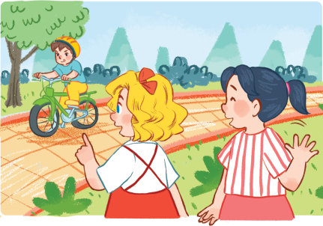
Is that Nam?
Yes, it is.
A
B
No, it isn’t.

Slide 12
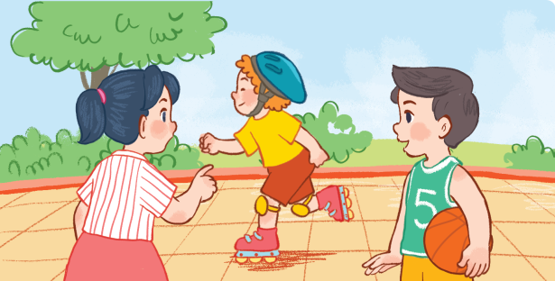
Is this Bill?
A
Yes, it is.
No, it isn’t.
B

Slide 13


Is that Ben?
A
Yes, it is.
No, it isn’t.
B

Slide 14

Is this Lucy?
A
Yes, it is.
No, it isn’t.
B

Slide 15
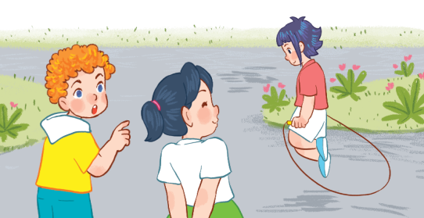
Is that Mai?
Yes, it is.
A
B
No, it isn’t.

Slide 16

Is this Mai?
A
Yes, it is.
No, it isn’t.
B

Slide 17


+2
+7
+15
-5
Choose 1
+3
BOMB - 10!
BOMB!
+10
Notes:
Click the colour, NOT the symbol to reveal the points pupils will get.
Nothing will happen if you click on the symbol.

Slide 18
+3
-5
+2
+5
Choose 1
+3
Switch Points!
BOMB!
BOMB - 10!
Notes:
Click the colour, NOT the symbol to reveal the points pupils will get.
Nothing will happen if you click on the symbol.

Slide 19
+20
+15
+15
+5
Choose 1
+25
BOMB -5!
+20
+10
Notes:
Click the colour, NOT the symbol to reveal the points pupils will get.
Nothing will happen if you click on the symbol.

Slide 20
+20
-10
+15
+15
Choose 1
+5
+10
BOMB!
+10
Notes:
Click the colour, NOT the symbol to reveal the points pupils will get.
Nothing will happen if you click on the symbol.

Slide 21

Notes:
G

