Slide 1



Slide 2



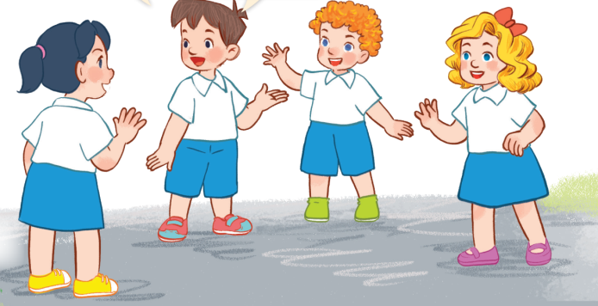
3
Our friends
LESSON 1 – PERIOD 1

Slide 3

CONTENTS
Warm-up & Review
1
2
Look, listen and repeat.
Listen, point and say.
3
4
Let’s talk.
Fun corner & wrap-up
5
Notes:
G

Slide 4



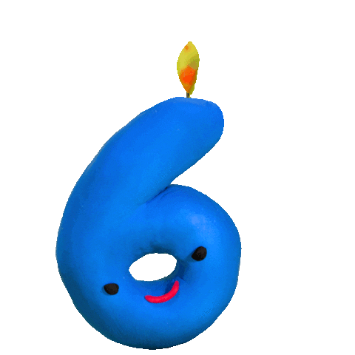





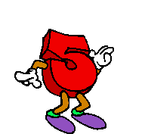
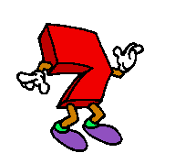
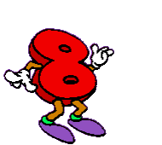

Team A
Team B
1
Warm-up & Review
REVIEW NUMBERS AND PATTERN OF AGE
HOW OLD ARE YOU?
Notes:
Chia lớp làm 2 đội.
Cho học sinh chọn số bất kì từ 1 đến 10 để đi đến câu hỏi.
Với mỗi câu trả lời đúng, giáo viên cho học sinh chọn một chiếc mũ để biết số điểm đội mình nhận được.

Slide 5






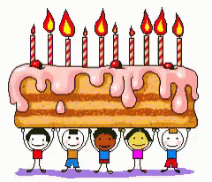

How old are you?
HOME
40
20
30
1/10
1
0
TIME’S UP
I am ten years old.
CHECK
Notes:
HS đọc câu hỏi, nhìn vào số để trả lời về số tuổi ‘’I am ten years old’’. HS trả lời đúng thì được chọn MŨ để biết số điểm mình nhận được.
GV nhấn vào mũ và sau đó nhấn nút Home để quay về SLIDE REVIEW, cho điểm và cho tiếp tục mời đội còn lại. Nếu HS chưa trả lời được, nhấn vào Check để hiển thị câu trả lời. GV cho cả lớp đọc to.

Slide 6

How old are you?
HOME
2/10
60
30
10
5
TIME’S UP
I am five years old.
CHECK

Slide 7

How old are you?
HOME
3/10
30
35
45
8
TIME’S UP
I am eight years old.
CHECK

Slide 8

How old are you?
HOME
4/10
50
60
15
4
TIME’S UP
I am four years old.
CHECK

Slide 9

How old are you?
HOME
5/10
40
50
20
9
TIME’S UP
I am nine years old.
CHECK

Slide 10

How old are you?
HOME
6/10
25
50
35
7
TIME’S UP
I am seven years old.
CHECK

Slide 11

How old are you?
HOME
7/10
25
15
30
6
TIME’S UP
I am six years old.
CHECK

Slide 12

How old are you?
HOME
8/10
40
10
5
1
TIME’S UP
I am one year old.
CHECK

Slide 13

How old are you?
HOME
9/10
2
20
30
40
TIME’S UP
I am two years old.
CHECK

Slide 14

How old are you?
HOME
10/10
25
10
35
3
TIME’S UP
I am three years old.
CHECK

Slide 15


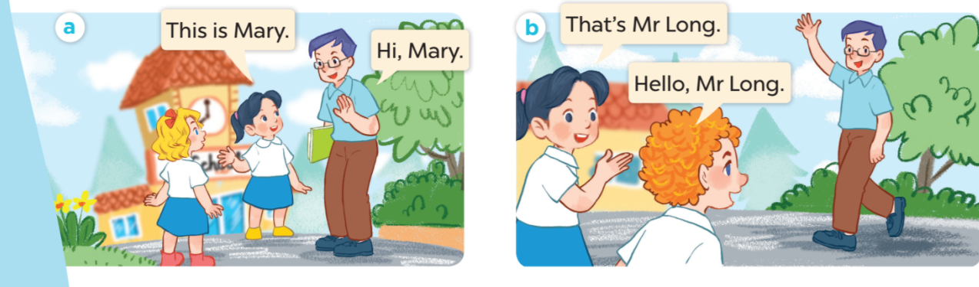

Slide 16

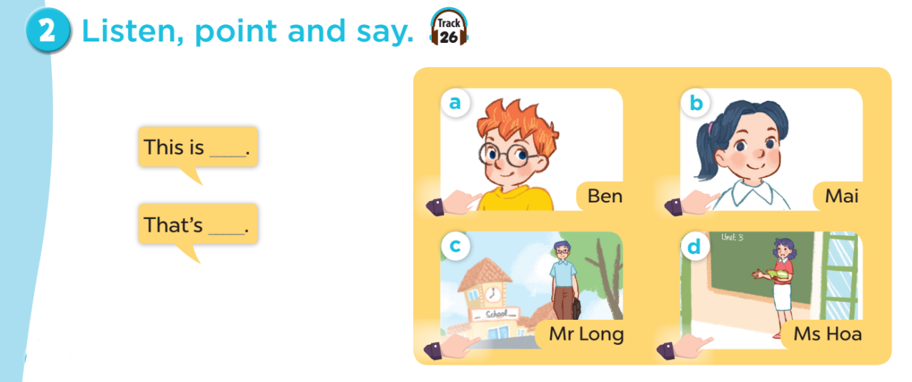

Slide 17
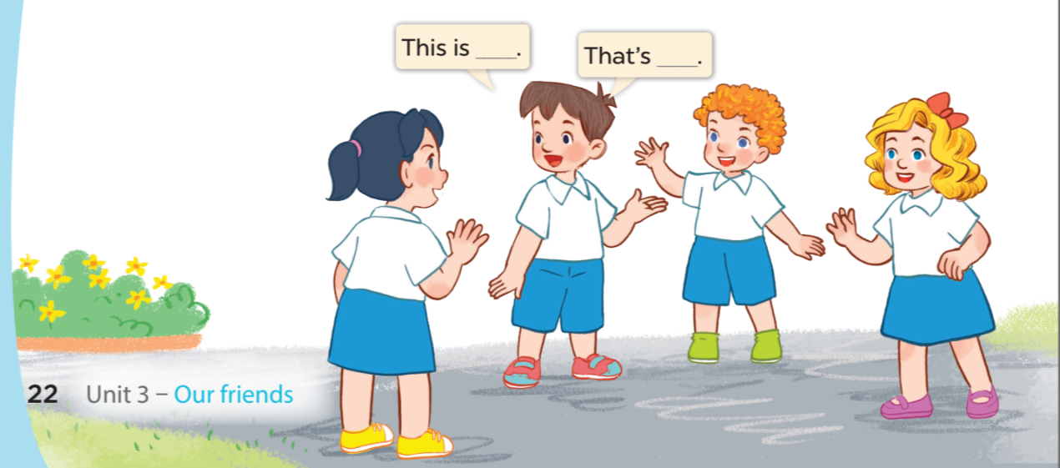


Slide 18

5
Fun corner & wrap-up
Singular
near
This is
This - Singular object near the speaker.
far
That is
That - Singular object far from the speaker.

Slide 19





Tug of war game
Notes:
Divide the class into 2 teams. Pupils will choose This or That to fill in the blanks. For each correct answer, pupils will get 5 stars for their teams.

Slide 20
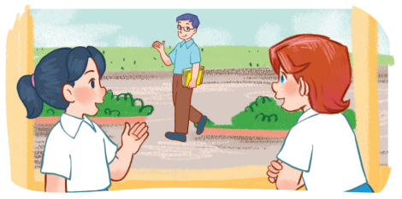




_____ is Mr. Long.
That
This
That
Notes:
Click the right answer. Click the arrow to move to the next question.

Slide 21



_____ is Mai.
This
This
That
Notes:
Click the right answer. Click the arrow to move to the next question.

Slide 22
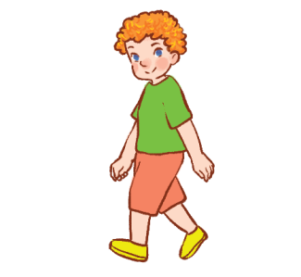
_____ is Bill.
That
This
That
Notes:
Click the right answer. Click the arrow to move to the next question.

Slide 23
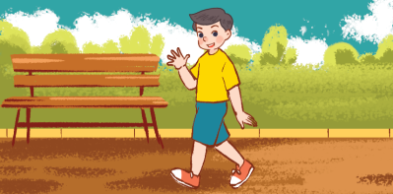
_____ is Nam.
That
This
That
Notes:
Click the right answer. Click the arrow to move to the next question.

Slide 24


_____ is Lucy.
This
That
This
Notes:
Click the right answer. Click the arrow to move to the next question.

Slide 25


_____ is Mary.
This
That
This
Notes:
Click the right answer. Click the arrow to move to the next question.

Slide 26


_____ is Nam.
This
That
This
Notes:
KÍCH VÀO CÂU ĐÚNG ĐỂ ĐÁP ÁN HIỆN RA

Slide 27


_____ is Ben.
This
This
That
Notes:
Click the right answer. Click the arrow to move to the next question.

Slide 28
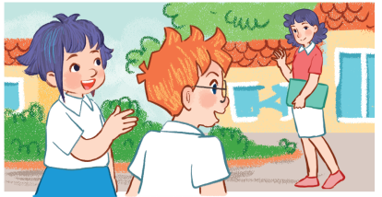

_____ is Ms. Hoa.
That
This
That
Notes:
Click the right answer. Click the arrow to move to the next question.

Slide 29
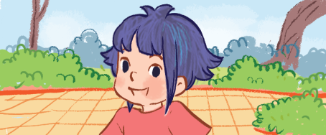

_____ is Linh.
This
This
That
Notes:
Click the right answer. Click the arrow to move to the next question.

