Slide 1


Our names
2
9
LESSON 3 – PERIOD 5

Slide 2
TABLE OF CONTENTS
01
02
03
04
05
WARM-UP
ACTIVITY 1
ACTIVITY 2
ACTIVITY 3
FUN TIME

Slide 3
WARM-UP
01

Slide 4

GAME

Slide 5










Notes:
CLICK THE CLOUD – GO TO ACTIVITY 1

Slide 6
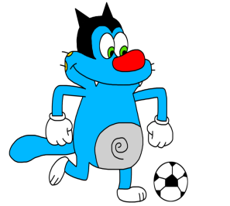


What’s your name?
Oggy
My name is ______ .

Slide 7
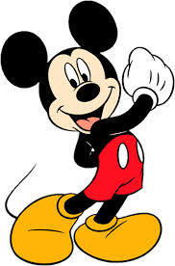

What’s your name?
Mickey
My name is ________.

Slide 8
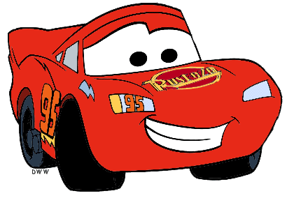
What’s your name?
Mc. Queen
My name is _________.

Slide 9
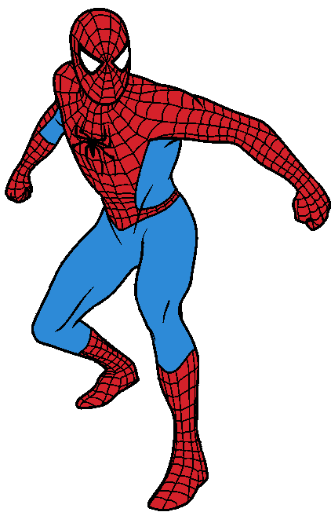
What’s your name?
Spiderman
My name is __________.

Slide 10
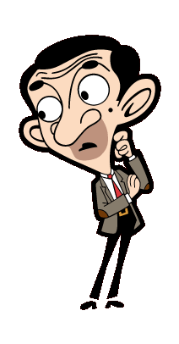
What’s your name?
My name is _________.
Mr Bean

Slide 11
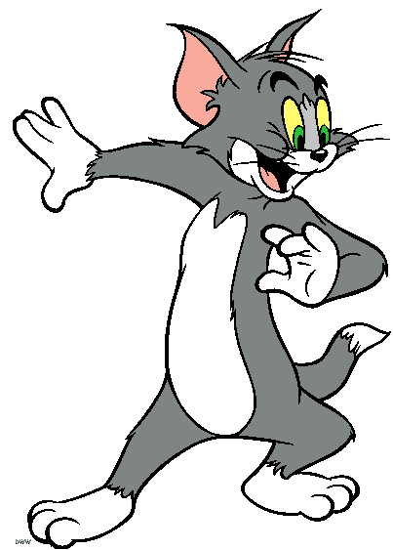
What’s your name?
Tom
My name is ______.

Slide 12
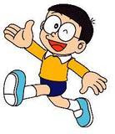
What’s your name?
Nobita
My name is _______.

Slide 13
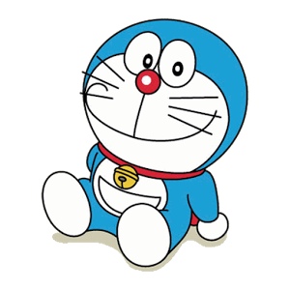
What’s your name?
Doraemon
My name is __________.

Slide 14
ACTIVITY 1
02

Slide 15
Let’s learn some sounds!
m
ary
M

Slide 16
Let’s learn some sounds!
n
N
am

Slide 17
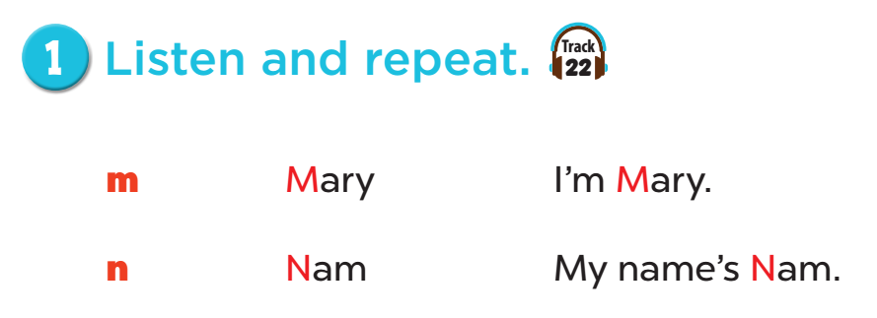

Slide 18
ACTIVITY 2
03

Slide 19
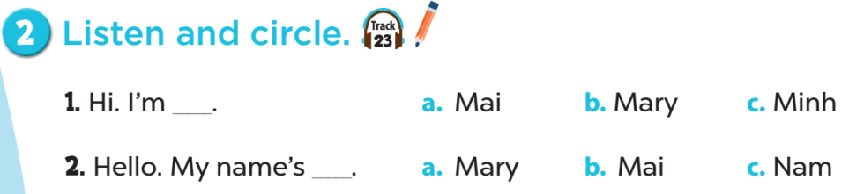

Slide 20
ACTIVITY 3
04

Slide 21
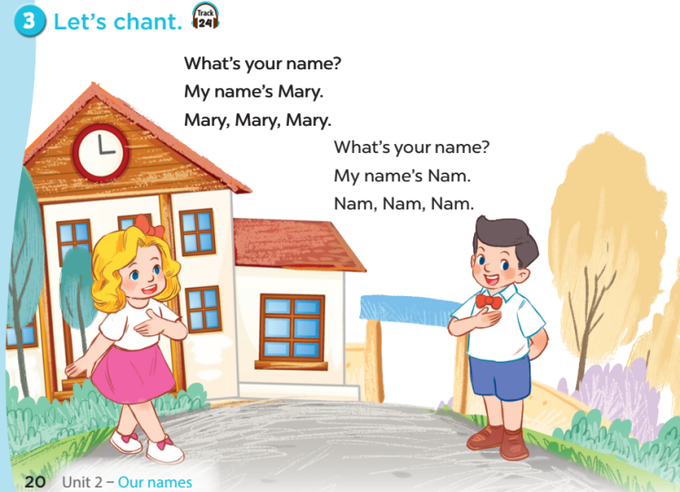

Slide 22
FUN TIME
05

Slide 23
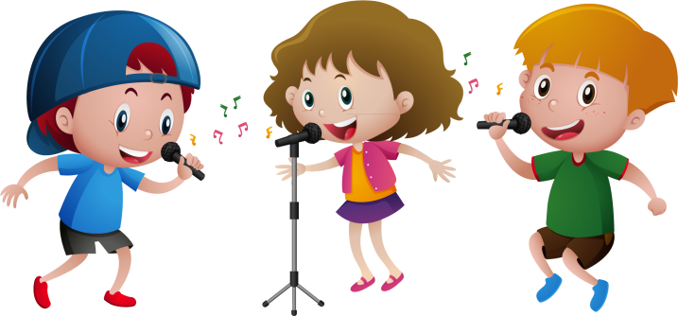
Let’s chant together!

