Slide 1


Our names
2
9
LESSON 2 – PERIOD 3

Slide 2
TABLE OF CONTENTS
01
02
03
04
05
WARM-UP
MODEL
SENTENCES
PRACTICE
LET’S TALK!
FUN TIME

Slide 3
WARM-UP
01

Slide 4
WHO’S FASTER?

Slide 5


Slide 6


Slide 7


Slide 8


Slide 9


Slide 10


Slide 11


Slide 12


Slide 13



Slide 14


Slide 15











Let’s count together!

Slide 16
MODEL SENTENCES
02

Slide 17
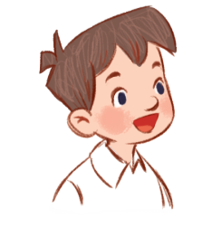

I’m Minh.
What’s your name?
Hello!
My name’s Mary.
Hi!

Slide 18
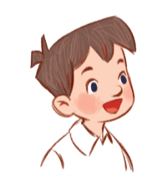

How old are you?
I’m …… years old.
eight
8

Slide 19

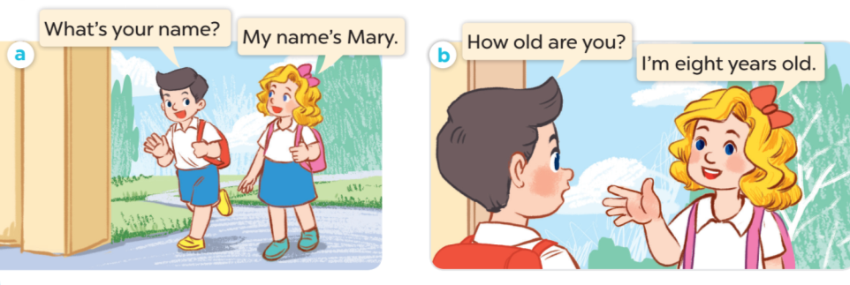

Slide 20
PRACTICE
03

Slide 21
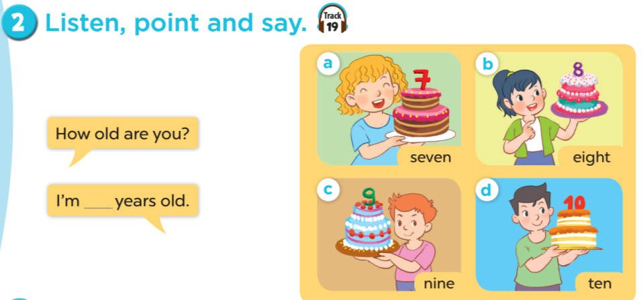

Slide 22


Slide 23


1. Work in teams (girls & boys)
2. Choose and answer.

Slide 24










Notes:
CLICK THE CLOUD – GO TO PART 4

Slide 25



How old are you?
I’m __ years old.
7
Notes:
CLICK PINK AMONG US – GO TO THE POINTS

Slide 26

How old are you?
I’m __ years old.
5
Notes:
CLICK PINK AMONG US – GO TO THE POINTS

Slide 27

How old are you?
I’m __ years old.
9
Notes:
CLICK PINK AMONG US – GO TO THE POINTS

Slide 28

How old are you?
I’m __ years old.
8
Notes:
CLICK PINK AMONG US – GO TO THE POINTS

Slide 29

How old are you?
I’m ___ years old.
10
Notes:
CLICK PINK AMONG US – GO TO THE POINTS

Slide 30

What’s your name?
My name’s ____.
Bill
Notes:
CLICK PINK AMONG US – GO TO THE POINTS

Slide 31

What’s your name?
My name’s ____.
Linh
Notes:
CLICK PINK AMONG US – GO TO THE POINTS

Slide 32

What’s your name?
My name’s ____.
Lucy
Notes:
CLICK PINK AMONG US – GO TO THE POINTS

Slide 33







Slide 34




Slide 35




Slide 36



Slide 37


Slide 38


Slide 39


Slide 40




Slide 41
LET’S TALK!
04

Slide 42
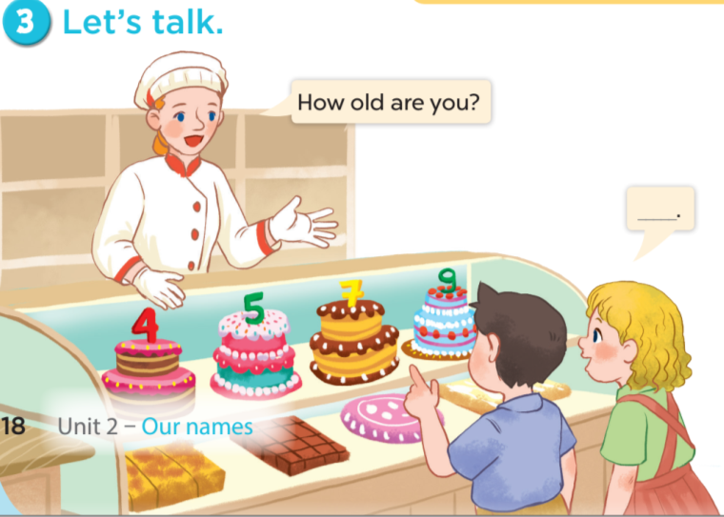

Slide 43
FUN TIME
05

Slide 44

5
10
1
7
8
SPIN
-5
3
9
-3
4
6
2
tekhnologic

