Slide 1


Our names
2
9
LESSON 1 – PERIOD 2

Slide 2
TABLE OF CONTENTS
01
02
03
04
05
SING WITH ME
REVIEW
PRACTICE
LET’S PLAY
FUN TIME

Slide 3

SING with ME
01

Slide 4
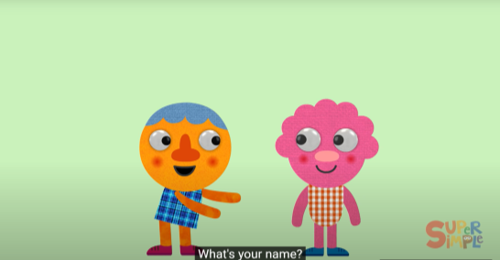
Notes:
https://www.youtube.com/watch?v=zMdq9jSaNLg

Slide 5
REVIEW
02

Slide 6
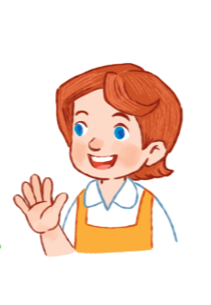

I’m Nam.
What’s your name?
Hello!
My name’s Lucy.
Hi!

Slide 7

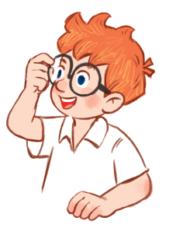
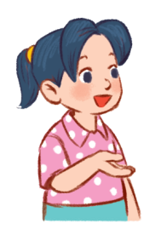
I’m Nam.
What’s your name?
My name’s …….
Mai
Ben

Slide 8

Pair work
What’s your name?
My name’s …….
Work in pairs, ask and answer about names, using the model sentences.

Slide 9
PRACTICE
03

Slide 10
ACTIVITY 4

Slide 11
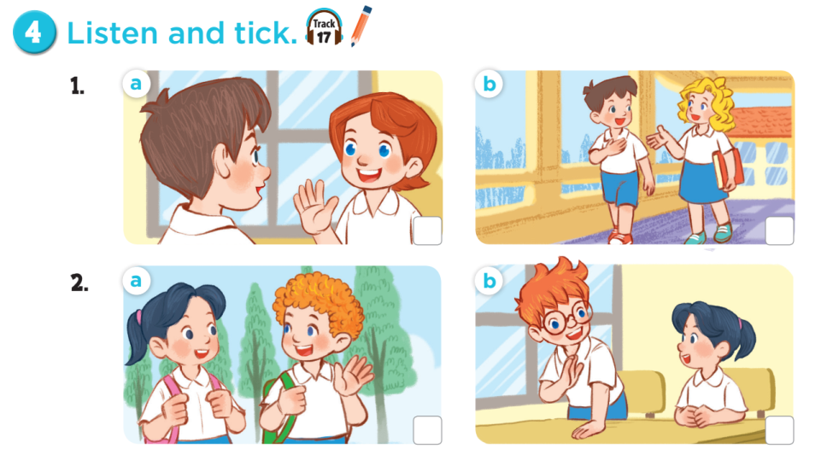

Slide 12
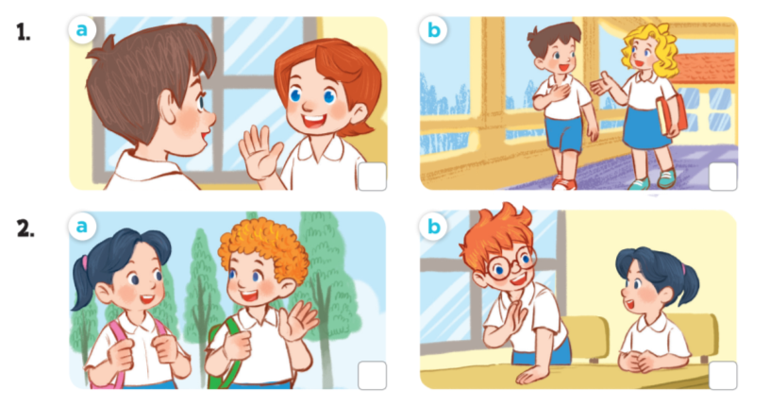
Ask and answer questions.
Notes:
Ask pupils some questions about Activity: How many pictures are there? Who can you see? What are they doing?

Slide 13




Slide 14
ACTIVITY 5

Slide 15
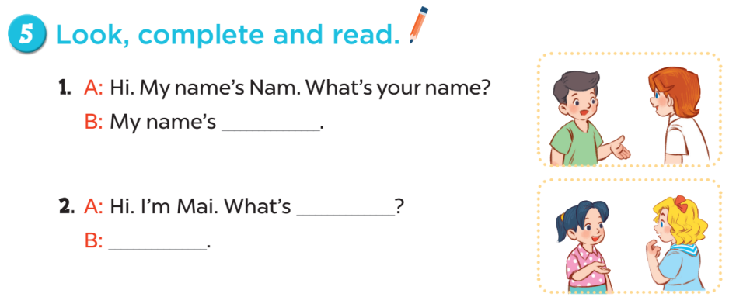
Lucy
your name
My name’s Mary

Slide 16
LET’S PLAY
04

Slide 17
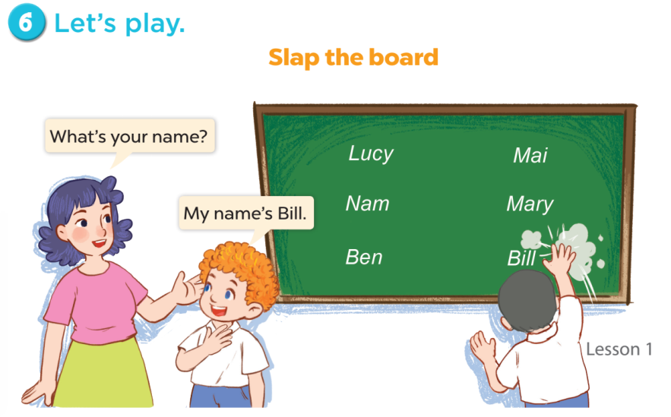

Slide 18
FUN TIME
05

Slide 19

Hello.
My name’s …….
5
2
1
8
-3
SPIN
10
10
9
3
1
7
-5
Notes:
12 Segments

