Slide 1



Slide 2


Our names
2
9
LESSON 1 – PERIOD 1

Slide 3
TABLE OF CONTENTS
01
02
03
04
05
WARM-UP
EXPLORATION
MODEL SENTENCES
PRACTICE
FUN TIME

Slide 4
WARM-UP
01

Slide 5

Sing with me!

Slide 6

Notes:
Youtube link: https://www.youtube.com/watch?v=tVlcKp3bWH8

Slide 7
EXPLORATION
02

Slide 8


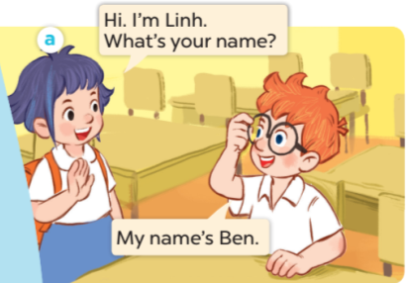
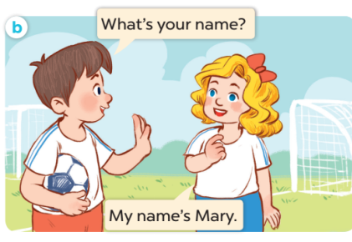

Slide 9
MODEL SENTENCES
03

Slide 10
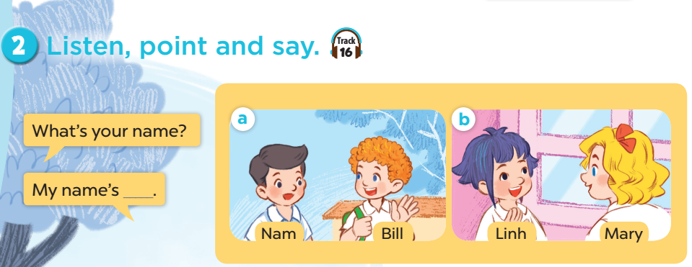

Slide 11


I’m Minh.
What’s your name?
Hello!
My name’s Lucy.
Hi!

Slide 12


I’m Minh.
What’s your name?
My name’s _____.
Mai
Ben

Slide 13

Blow up balloons
Notes:
Divide the class into 2 teams. Let each pupil choose a balloon by its colour. Pupil(s) answer the question(s). If their answer(s) are correct, they get points (behind each balloon) for their teams. The winning team is the team with more points.

Slide 14







5
15
15
20
5
10
25

Slide 15



What’s your name?
Nam

Slide 16



What’s your name?
Mary

Slide 17

What’s your name?
Bill

Slide 18
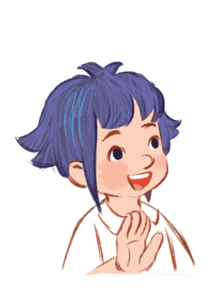

What’s your name?
Linh

Slide 19

What’s your name?
Ben

Slide 20

What’s your name?
Mai

Slide 21


What’s your name?
Lucy

Slide 22
PRACTICE
04

Slide 23
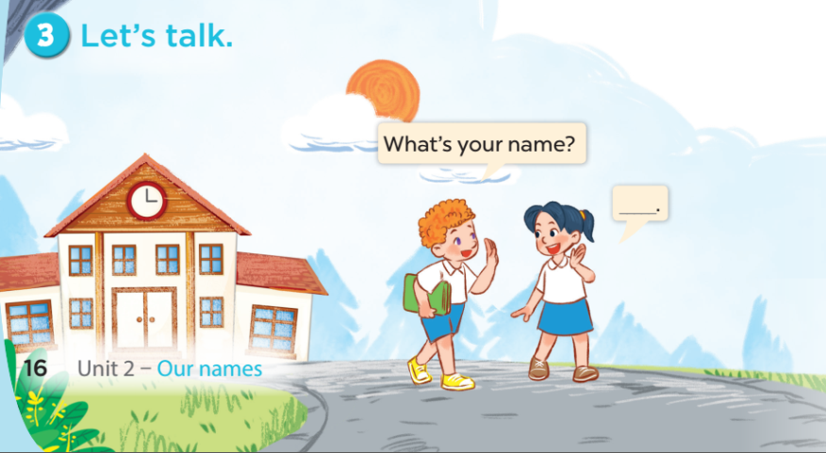

Slide 24
FUN TIME
05

Slide 25
Let’s ask people around you!
 | What’s your name?
You | NGUYÊN
Your friend | …………………………………………………
Your grandma / grandpa | …………………………………………………
Your mom / dad | …………………………………………………
Your sister/brother | …………………………………………………

